Slide 2
Quick & Reliable One-off Access
The 2N Access Unit QR provides quick, secure access using mobile phones and is perfect for visitors!
Co-working spaces
Sports facilities
Late arrivals or deliveries (when there’s no staff on site)

Slide 3
Part of the 2N Access Unit 2.0 family…
Puts all decision-making intelligence right at the door
You only need a single network cable for internet connection and power supply (PoE)
Onboard input, active output, and relay (possibility to add additional I/O modules)
2N OS makes it smart & secure

Slide 4
…with some differences!
2N Access Unit QR is a two-module reader that:
Has the same great design as the 2N IP Verso 2.0 but is made to be installed in places that don’t need a calling function – for example, elevators, co-working spaces, sports facilities, and so on.
Requires 2-module mounting accessories (frames, boxes, backplate)
Is only available in the nickel finish

Slide 5
Frictionless visitor experience
No more remembering PIN codes or waiting at the desk for a temporary RFID card. Enhance the visitor experience by allowing receptionists to email a QR code in advance for mobile access control.

Slide 6
The best temporary access
Whether it’s one-off entry, time-limited access, or just a certain number of visits, QR codes are the best credential for guests, providing convenience for visitors and flexibility for admins.

Slide 7
Complete flexibility
The modular design of the reader allows you to add another access module (e.g. Bluetooth & RFID), offering more flexibility for visitors as well as daily access options for personnel.

Slide 8
Reduced administrative overhead
Free, more sustainable credentials
Full HD camera enhances security
Generate QR codes and share them in bulk to multiple users with a few clicks in the 2N Access Commander. Or, use third-party software.
Reduce plastic waste and your spending: QR codes are free and eliminate the costs associated with the purchase of physical credentials, their handling, issuing, and disposal
Supplement access logs in the 2N Access Commander with snapshots captured by the reader's camera. Or fully integrate the reader into your VMS.

Slide 9
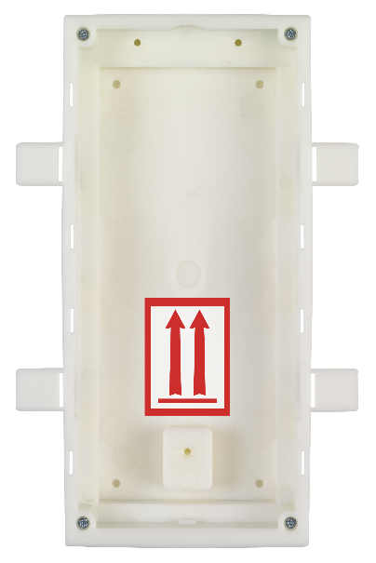
Mounting options & accessories
SURFACE
Frame Backplate
(2 modules) (optional, for glass)
The 2N Access Unit QR is only available in nickel with the option of surface or flush mounting.
It is compatible with all modules from the 2N IP Verso 2.0 intercom.
FLUSH
Main unit (03089-001)
Frame Box (mandatory)
(2 modules)

Slide 10
Technical parameters
Datasheets link
Power supply
Type | PoE and/or 12 V/1 A DC
PoE | 802.3af (Class 0–12.95 W)
Interfaces
LAN | 10/100BASE-TX with Auto-MDIX, RJ-45 jack
Recommended cabling | Cat-5e or better
Active switch output | 8 to 12 V DC/max 400 mA
Passive switch | NO/NC contacts, up to 30 V/1 A AC/DC
Inputs | 1 input - in passive/active mode (-30 V to +30 V DC)
Tamper switch | optional (extension module)
QR code specifications
Type | static QR containing 4-15 digits (decimal, hexadecimal)
Versions | 1 - 40 (all the versions supported)
Others | QR code can be coloured and can contain an image
Audio
Microphone | 1 integrated
Amplifier: | 5 W (Class D)
Speaker | 2 W / 8 Ω
Sound Pressure Level (SPL max) | 78 dB (for 1 kHz at 3.281 ft.)
LINE OUT | 1 VRMS / 600 Ω
Volume control | adjustable with automatic adaptive mode
Full duplex | Yes (AEC)
Audio output | 1.9 W
Protocols | RTP/SRTP
Codecs | G.711, G.729, G.722, L16/16kHz
Camera & video
Sensor | 1/2.7'' colour CMOS
Focal length | 0.075 inch
View angle | 125° (H), 105° (V)
View angle "peephole" | 138° (H), 105° (V)
Infrared light | yes
WDR | yes
Minimal illumination | 0,8 lux without IR illumination
Protocols | RTP/RTSP/RTCP/HTTP, ONVIF v2.4 profile S & T
Codecs | H.264, MJPEG, Zipstream
Resolution H.264, MJPEG | max. Full HD (1920 x 1080)
Frame rate | max. 30 fps
Mechanical Properties
Frame (cover) | robust zinc cast frame with surface finish (nickel and black color)
Operating temperature | -40°F to +140°F
Storage temperature | -40°F to +158°F
Operating relative humidity | 10%-95% (non-condensing)
Weight | 4.41 pounds
Cover rating | IP54 and IK08
Dimensions
Surface mounting (2 modules) | 4.213 (W) x 9.213 (H) x 1.102 (D) inch
Flush mounting (2 modules) | 5.118 (W) x 10.118 (H) x 1.772 (D) inch

Slide 11
2N Access Unit QR Quick & Reliable One-off Access

