Slide 1
2N Residential Portfolio
Future-proof, smart, integrated

Slide 2
Modern Residential Projects
IP technology
Mobile access
The Key Elements:
Bring your customers added value by implementing these 4 things into your project's solution:
Prioritize cybersecurity
Easy integration

Slide 3
IP Technology
IP-based installations are powerful because they:
Make configuration and integration simple, secure, and reliable.
Are the only installations that combine modern services with maximum comfort.
Are easier to project and quote, and also easy to extend and update.

Slide 4
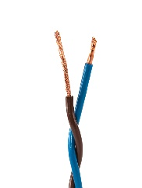
IP vs. 2-wire
Remote management over the internet
Familiar tech for on-site IT staff |  |  | Requires electrical installer knowledge
Uses existing IP network cabling |  |  | Dedicated cables – not future proof
Open protocols |  |  | Proprietary protocols
One type of cabling needed for installation
Easy scalability |  |  | Limited scalability with extra hardware required
Easy to integrate with 3rd party systems
Low vulnerability to interference |  |  | Can create noise: buzzing, humming
High audio and video quality |  |  | Can create noise: buzzing, humming
Easy configuration
Advanced functions
Let’s compare IP to 2-wire door entry technology

Slide 5
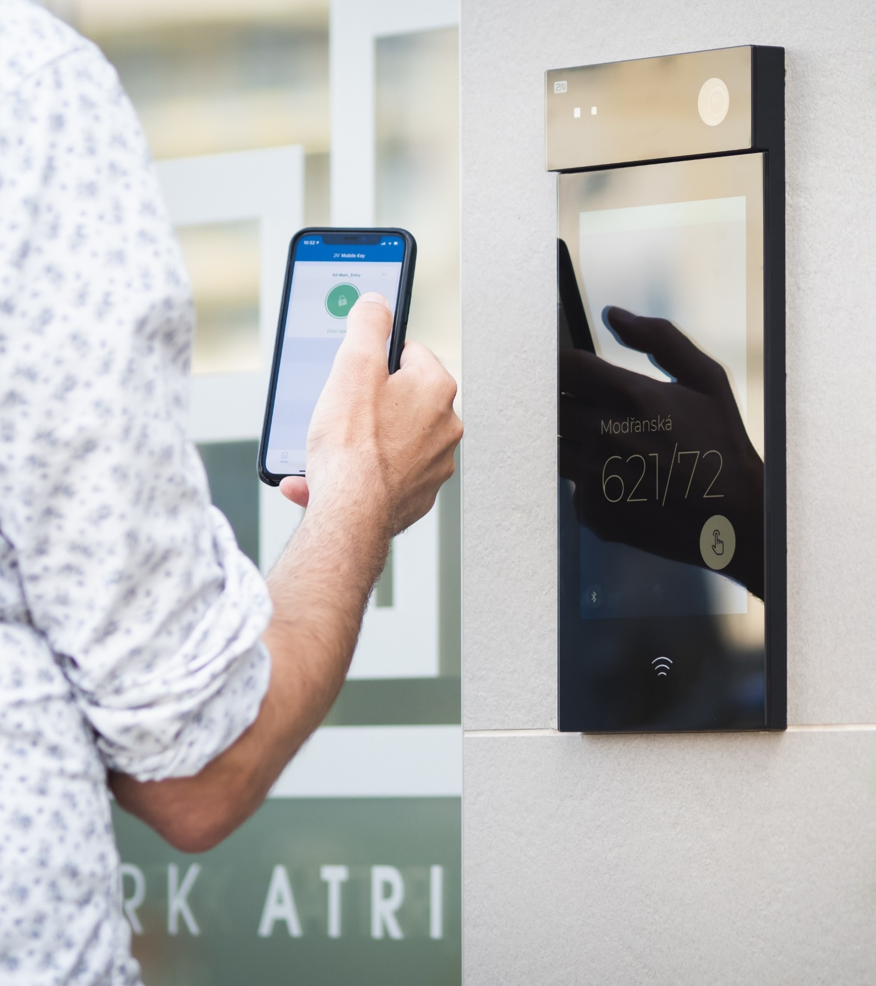
Mobile Access
Thanks to mobile phones, the wallet is a relic of the past. Now, forget about keys, too!
Offer customers 2N's patented Bluetooth access technology WaveKey: the only mobile access technology that is reliable, fast and secure.

Slide 6
Cybersecurity
Never underestimate the importance of cybersecurity.
A 2N residential door entry system is:
Cybersecure by design
GDPR compliant
ISO 27001 certified

Slide 7
Integrations
Offering one global solution is the key to success!
2N products are fully compatible with more than 200 brands in the fields of:
Home automation
VMS
Access control
...and more!

Slide 8
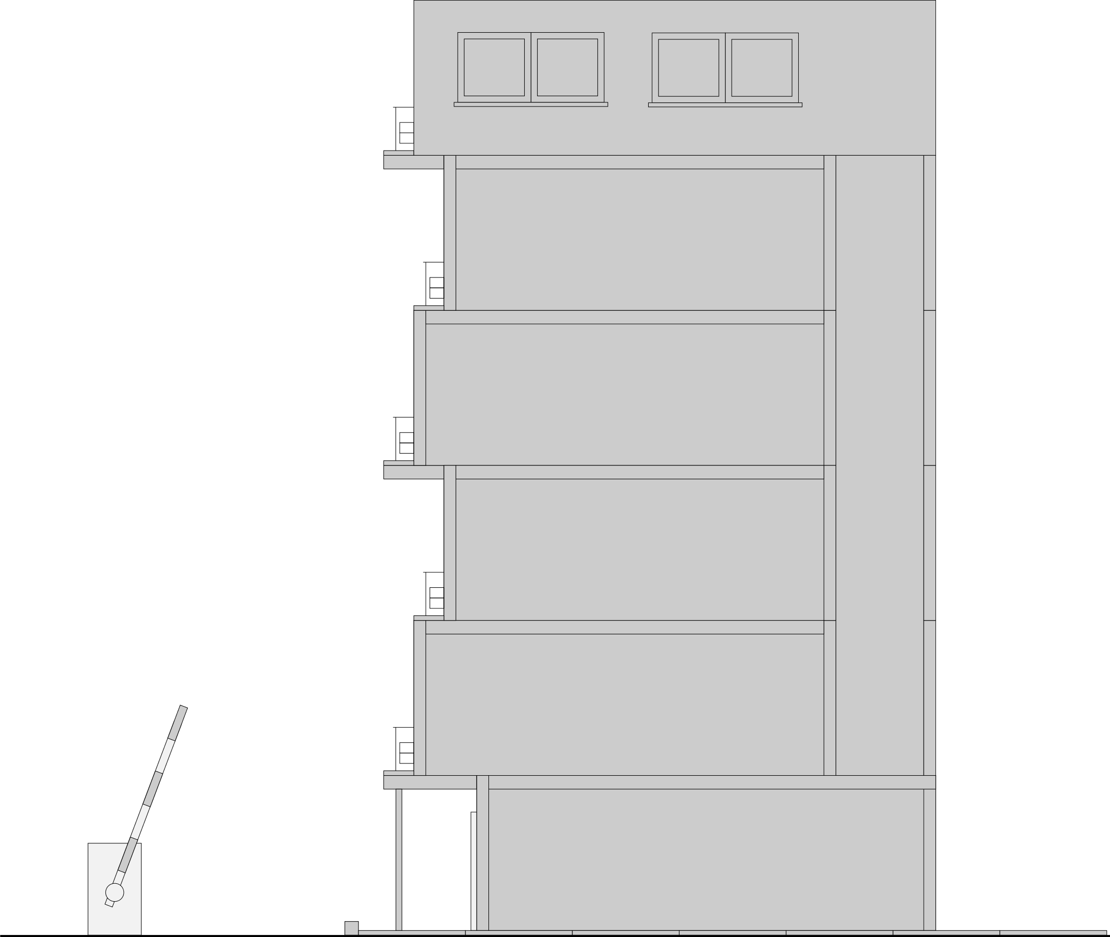
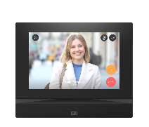
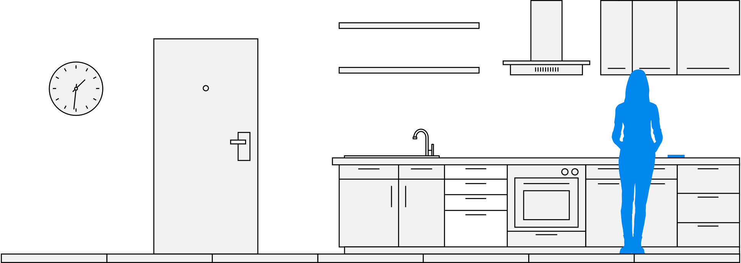
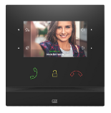
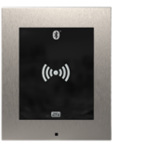
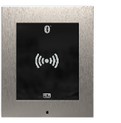
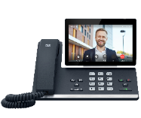
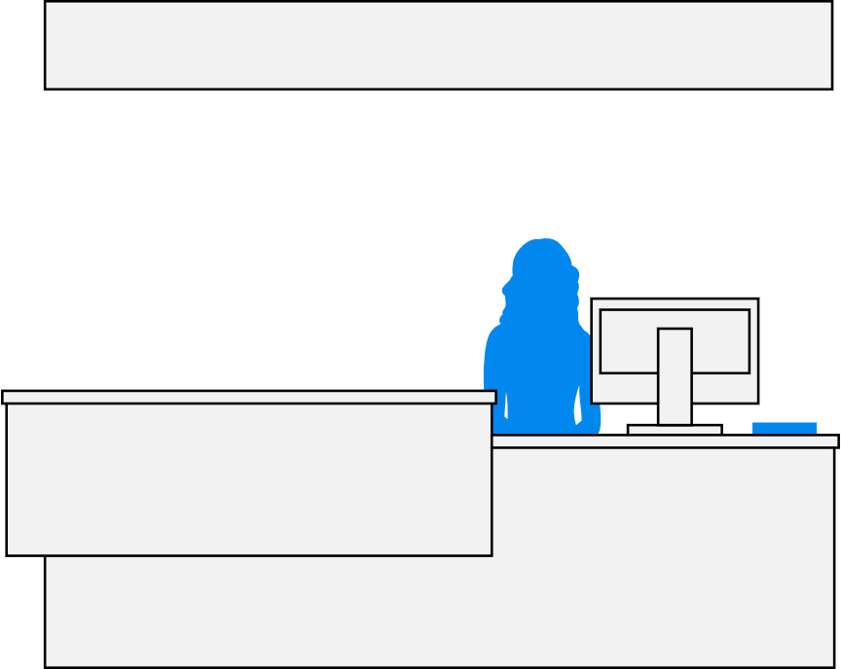
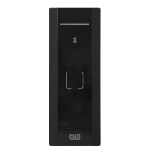
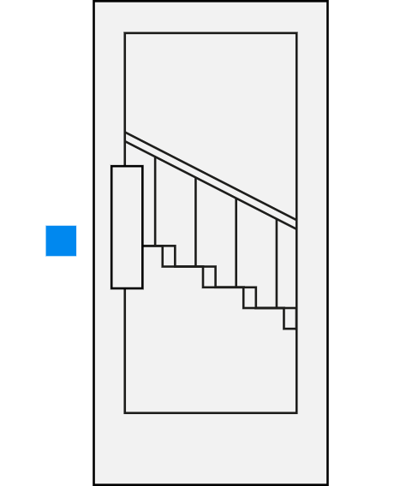
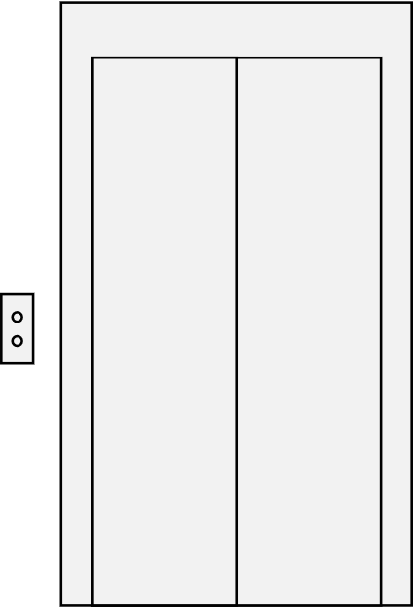
Complex Door Entry Portfolio
2N® Indoor
View
Answer videocalls from the intercom
The My2N Management Platform
My2N App
Manage the site remotely
Answer videocalls on your mobile phone
2N® Indoor
Compact
Answer videocalls from the intercom
2N Access
Unit 2.0
Allow access to the tenants’ floor
2N Access
Unit 2.0
Allow access
to amenities
2N® IP Force
2N® IP Verso 2.0
2N® IP Phone D7A
2N Access Unit M
Welcome your visitors with endless possibilities
Allow access
to common spaces
Secure parking lots
Please receptionists with a smart device

Slide 9
Main Entrance

Slide 10
2N® IP Style
Defining future standards for video intercoms

Slide 12
2N® IP Style Features
The camera of the future
Enhance your projects with an intercom which can handle multiple simultaneous Full HD streams and has a 5 MP chip. It supports WDR and provides clear colour images, even in low-light conditions.

Slide 13
2N® IP Style Features
Mobile Access Control
Offer smooth, secure and reliable access to buildings with our WaveKey technology.
Premium 10“ Display
The extreme brightness of the display guarantees excellent readability, even in direct sunlight.
IP65 and IK08 Durability
The 2N® IP Style can easily resist heavy rain, a dusty environment, and even attacks by vandals.

Slide 14
2N® IP Verso 2.0
Create a door intercom for any project imaginable

Slide 16
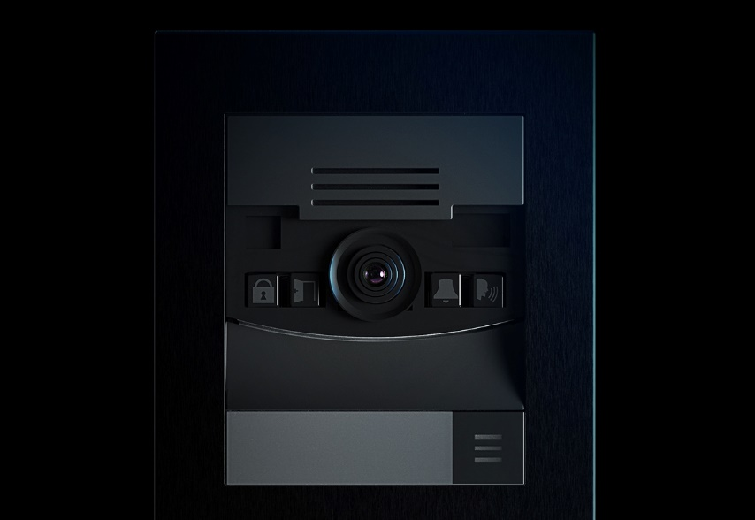
2N® IP Verso 2.0 Features
Wide-Angle Full HD Camera
It provides crystal-clear colour images, supports WDR and maintains image colour even in low light conditions.
Advanced Modularity
Combine 16 different modules and 4 installation options to create the ideal intercom for your project.
Choose any Access Control Option
RFID readers, keypads, fingerprint readers, Bluetooth readers and/or a combination of them all.

Slide 17
Apartments

Slide 18
2N® Indoor View
Experience touch responses at lightning speed

Slide 19
2N® Indoor View Features
7“ HD Touch Screen
Your customer will love how easy the unit is to operate and will be amazed by full-screen video calls on the large display!
Video Surveillance
The resident can see what’s going on anywhere where there’s an IP camera installed (for example in the hallway, garden or garage).
Smart-Home Integration
The resident can turn on the air-conditioning or call the lift directly from the display on their unit. The unit can send up to 3 different HTTP commands.

Slide 20
2N® Indoor Compact
Midsized high-end video answering unit

Slide 21
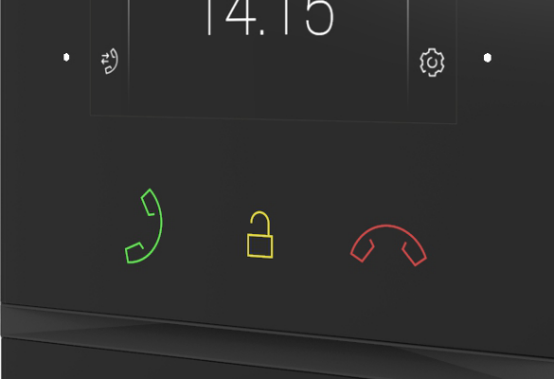
2N® Indoor Compact Features
4.3“ Colour Screen
The large display transmits clear video calls with visitors and also allows for a wide overview of what’s happening in front of the house.
Backlit Touch Buttons
The unit is controlled by seven capacitive buttons that are colour-backlit and react quickly to the user's touch.
Tempered Glass Surface
The 3 mm thick glass is chemically hardened at 420 °C in a salt bath which allows us to achieve maximum resistance to scratches and impact.

Slide 22
2N® Clip
The power of IP for every home

Slide 23
2N® Clip Features
Perfect for Mid-Range Projects
You’ll get IP video, good design, and the reliability of 2N's products without the premium price tag.
Increase Security. Upgrade to IP Video
Forget blurry videos from outdated analog units. High-quality IP video is the new norm in modern living.
Fits Seamlessly into the 2N Ecosystem
The 2N® Clip runs on the powerful, reliable 2N OS – the same as the most premium of products from our workshop.

Slide 24
My2N App
Answer the door from anywhere

Slide 25
My2N App Features
99.98% Reliability
You can't offer your customers a more reliable intercom-to-mobile calling solution than the My2N app!
Constant Video Surveillance
The user can see what’s happening outside their front door at any time on their mobile phone.
More than Just Calls Residents will appreciate video previews shown before answering calls, accessing call logs, and the possibility to take photos during the call.

Slide 26
Car Parks

Slide 27
2N® IP Force
The most durable IP intercom in the world

Slide 28
2N® IP Force Features
Extreme Durability
Certified IP69K and IK10 standards make the device both waterproof and antivandal.
Wide-Angle HD Camera
Monitor events around the intercom with the integrated HD camera. It has a 135° view and night vision mode.
Robust Access Control
Control access using the reader, keypad, or the integrated camera and achieve a greater level of security.

Slide 29
Common Spaces

Slide 30
2N Access Units
You only need 1 device for 1 door

Slide 31
2N Access Units Features
Controller and Reader in One
Speed up installation time and save on cabling costs, as you only need 1 device for 1 door.
Stay Ahead with Mobile Access
Offer your customers the future of access control technology. Bluetooth readers supports WaveKey technology.
Combine Technologies
Bluetooth, RFID, PIN and fingerprints. Choose one or combine them in a single reader.

Slide 32
Reception

Slide 33
2N® IP Phone D7A
Smart IP phone for residential receptions

Slide 34
2N® IP Phone D7A Features
One Touch Door Opening
Preview the person waiting on the built-in 7’’ touchscreen display and open the door at the mere touch of a button.
Download Applications
2N® IP Phone D7A is equipped with Android OS, which allows apps such as Skype or Zoom to be installed.
Optional Bi-Directional Video
Connect a USB camera accessory and add a function which allows you to cater for the hearing-impaired.

Slide 35
Remote Management

Slide 36
The My2N Management Platform
Streamline the management of your installations

Slide 37
Features of the My2N Management Platform
Cloud Calling
You can set up a video call from an intercom to a smartphone or answering unit in just a few minutes.
Access Control
Manage user access rights in the intuitive My2N Management Platform environment.
Remote Management
You can add and remove users and devices, update firmware, diagnose and troubleshoot from anywhere.

Slide 38
Retrofit Ready

Slide 39
Retrofit Ready
Don’t let legacy cabling hold you back!
Use the Existing Cables
Connect the IP intercoms and answering units to the converter and then connect the converters to the existing 2 wire cables.
Cloud Calling via My2N
The integrated SIM card slot in the 2N® LTE Verso means that connecting video calls via the cloud couldn't be simpler, even without cables.
Retrofit projects can be challenging: it's often difficult to get cabling installed. 2N offers several simple solutions.

Slide 40
Handy Online Tools
We help you on your journey to a successful project
Project Designer
CAD/BIM
Integration HUB
AppeAR
Create your door entry project quickly and easily online
Ready-to-use 2D drawings and BIM objects of our products
Find a partner to integrate your 2N device with: there are over 200!
Our mobile app allows you to virtually install every 2N device in AR

Slide 41
Why 2N
A Complete Portfolio
Reliability
Local Support
Intercoms, smart access readers, answering units and mobile-ready products for end users: we have everything you need.
Premium devices with long equipment lives. Futureproof products: new features are added for free with every 2N OS update.
Active sales and technical support. Worldwide sales representatives and distributor chain.
Endless Integration
Remote Management
3 Year Warranty
2N devices are built on open protocols, allowing for easy integration with 3rd party solutions.
Connect to the product remotely and handle 4 out of 5 of your customers' requests from your home or office.
We make high quality products that last. Purchase an extended warranty of 5 years for extra assurance, too.

Slide 42
Offer your customers the modern standard of residential door entry

