Slide 1
Part of the
2N Access Unit
Multi-technology access control readers

Slide 2
Agenda
The product family - introduction
Typical use cases
Mounting and accessories
Administration
Product comparison

Slide 3
Quality meets design
Innovative look of readers matching the intercoms’ makes the installation stand out
First-class and durable (scratch-free) materials
IP and IK certified as they are dust, water and impact resistant – outdoor installation
Proudly made in the European Union
Notes:
Access Unit 2.0 … IP54/IK08, recessed installation
Access Unit M … IP55/IK07

Slide 4
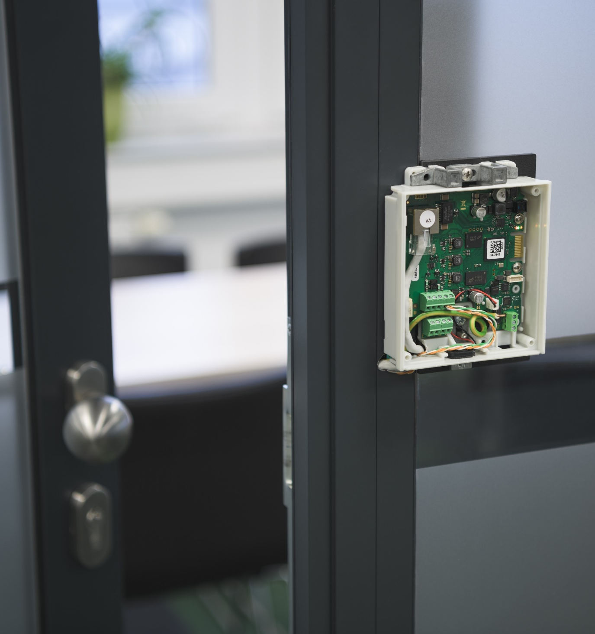
Reader with already built-in controller
Edge device brings all the decision-making intelligence right at the door
Only a single network cable for connection and power (PoE)
Onboard input and output relays
30% faster installation compared to traditional systems saving material and labor cost

Slide 5
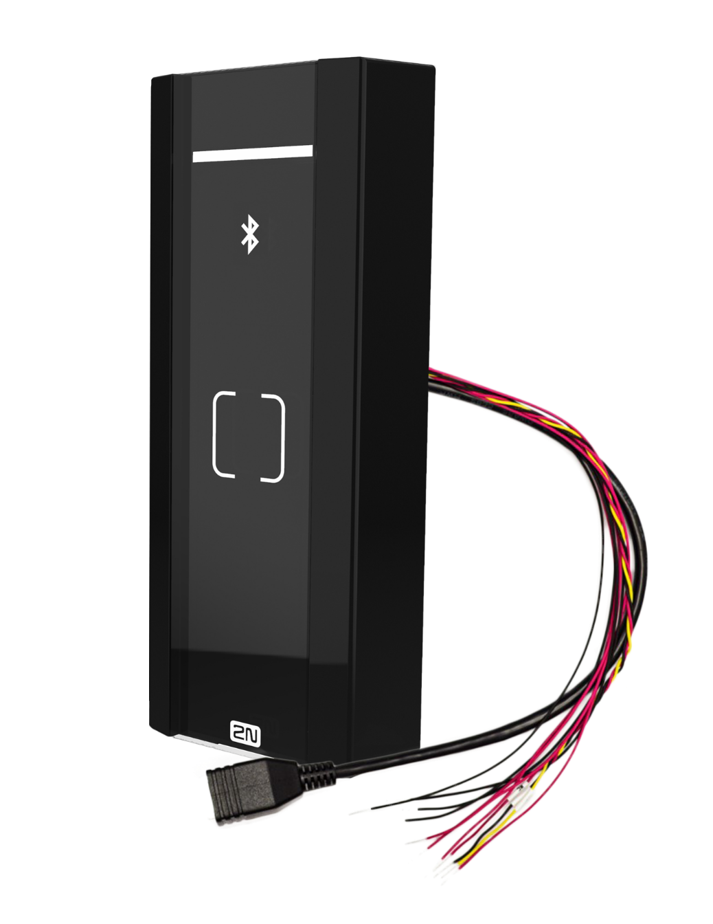
Simple quotation
Do you need to propose the access control solution for a project with 40 doors?
Typical questions…How many controllers do I need, how many extension boards, what type of interfaces, cabling?
Stop thinking in this way! Simply offer 40pcs of 2N Access Unit M
Notes:
And edge device has one more benefit for you and it is really simple quotation.
Imagine, that you have a project where you need to control the access to 40 doors…
What do you start thinking about right away? What controller willl I choose, how many extension boards, what type of cabling, etc, right?
Stop thinking in this way! ☺ ☺
It is so easy…do I need to control the access to 40 doors? I can simply offer 40pcs of 2N Access Unit M and connect them to the existing shared network infrastructure
The only thing you need to choose is the right access technology which works the best for your customer…

Slide 6
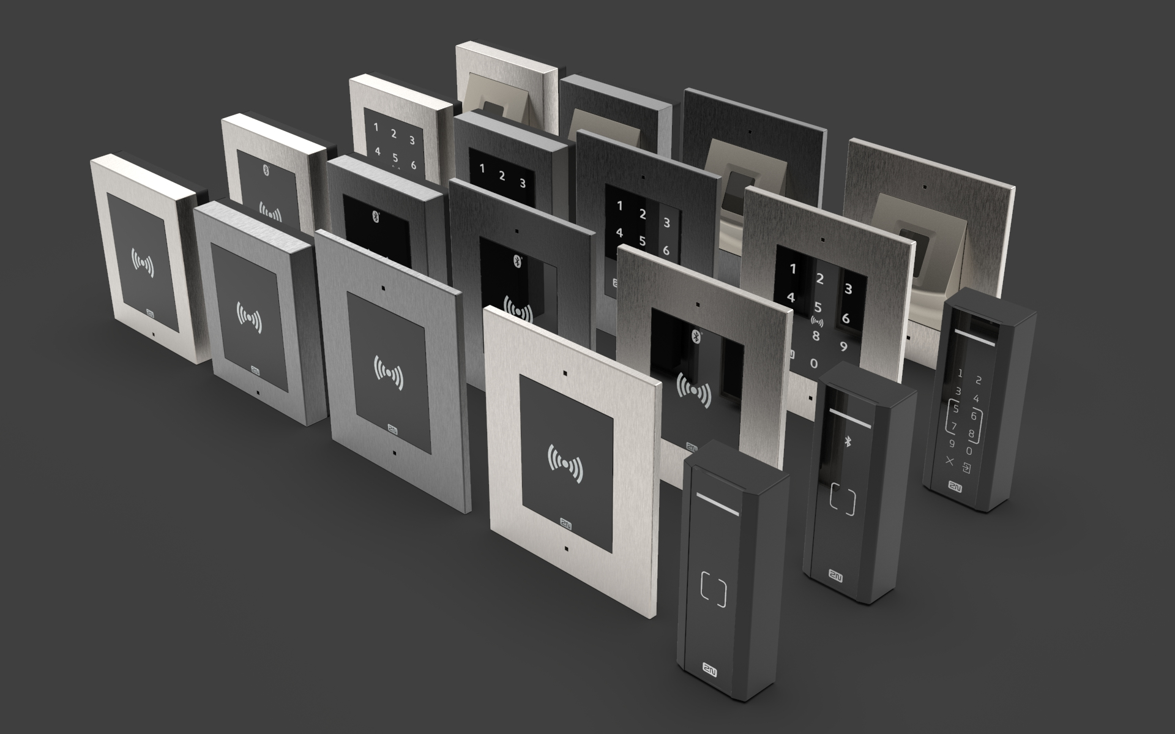
Variety of access control technologies
RFID reader (125kHz or/and 13.56MHz)
Supports also secured iCLASS Seos cards (only 2N Access Unit 2.0)
Bluetooth reader (and NFC)
2N mobile access = reliability, incredible speed and convenience
Touch mode, tap in app mode and NFC
PIN keypad
Allows two-factor authentication or usage of one-time PIN access
Fingerprint reader (only in 2N Access Unit 2.0)
Notes:
Multi-technology readers allowing multi-factor authentication for even higher security level

Slide 7
2N OS makes readers smart and secure
Smart means integrated – open protocols for integration with 3rd party systems
„Automation“ section to set up advanced scenarios
„Hack-resistant“ system – encrypted communication, multi-factor authentication, 802.1x, anti-passback
Notes:
Then the cherry on the top that differentiates us from the competitors is our own 2N OS.
Smart means that our readers are based on open protocols and you can easily integrate with any 3rd party solution like Genetec, Milestone, etc.
Another added value of our readers for you is so called Automation section which allows you to dleiver advanced unusual access control scenarios thanks to the combination of different events, actions and conditions. For example if the doors are open too long out of working hours, the reader can send HTTP command to security guard and pop-up the video preview from the camera nearby.
2N Os makes the reader also very secure with fully encrypted communication, multi-factor authentication, support of ant-passback and 802.1x protocol that prevents unauthorized access to the comapnie’s LAN network.

Slide 8
Typical use cases
(MDU and office buildings)
Notes:
Residential buildings – MDU
Office – focus on SME / SMB market

Slide 9
Meeting rooms and offices
Convenient way of acces ussing the mobile phone
Just touch the reader to open the door (while having the phone in the pocket or bag)
Tap the icon in the app to open the door
Faster than RFID, secure and totally reliable
Shared spaces in the building
More companies in the building using different readers (on different frequencies) sharing some spaces
Helps facility managers of the office building to smoothly transit to smart cards over time
Reduces the initial one-time investment
Notes:
In office buildings of today employees want even more convenient access control solution without having to carry additional cards. They want to use their smartphone. And that’s exactly what you can offer them with our mobile access control via Bluetooth. They open the door simply by touching the reader, even with their elbow, with the phone in their pocket or bag. 2N mobile credentials are for free so the facility manager saves the money associated with the distribution of mobile credentials. As you will see in next presentation, our solution is faster than RFID cards, totally secure and absolutely reliable…so you can trust to it!
Multi-frequency RFID reader that helps facility managers of office building to smoothly transit to smart cards over time

Slide 10
Highly protected areas
Server room, warehouse, cleaning room need a higher level of security
Multi-technology readers for two-factor authentication
Possible combination with time profiles
Part of a lift access control
Ideal for apartment and office buildings up to 64 floors
Floors with restricted access become available after the successful identification of the user
Publicly accessible floors without the need for identification
Works with Axis A9188 I/O relay
Notes:
Combination of RFID with keypad which is an ideal choice for highly protected spaces where you need two-factor authentication or the use cases where you need to deliver one-time PIN access.

Slide 11
Mounting and accessories

Slide 12
2N Access Unit M
No mounting accessory available
The installation anchor is part of the package
Only surface type of the installation
on the door frame or on the wall
RJ-45 pigtail (female connector)
11-wires (IN1, IN2, Active OUT, Relay, External power)

Slide 13
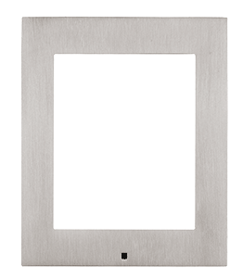
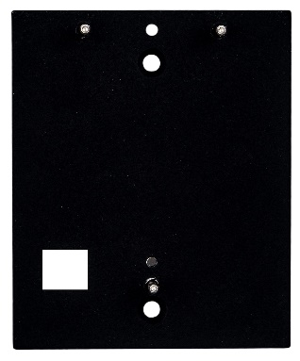
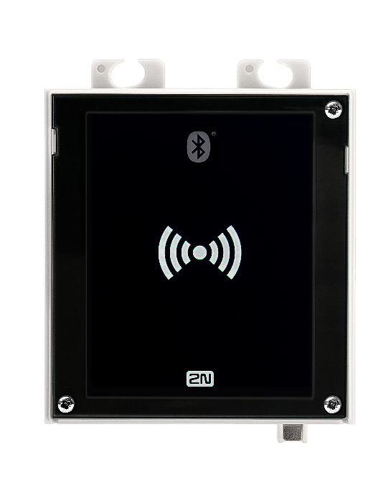
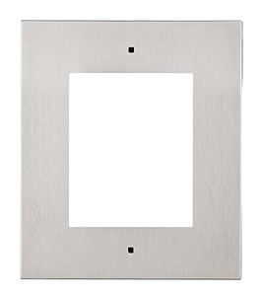
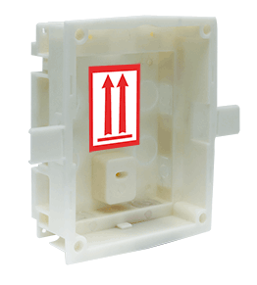
2N Access Unit 2.0
Frame for surface installation
No other accessories are needed for surface installation of the intercom/access control reader.
Backplacte for glass mount
Enables installation on glass or uneven surfaces.
SURFACE
Frame for recessed installation
The wider frame covers the uneven edges of a drilled hole, it is 5mm above the surface.
Box for recessed installation
Flush mounted box for walls or plasterboard
RECESSED

Slide 14
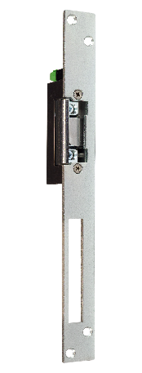
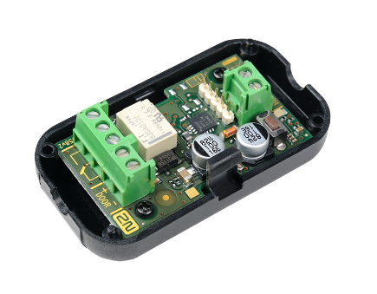
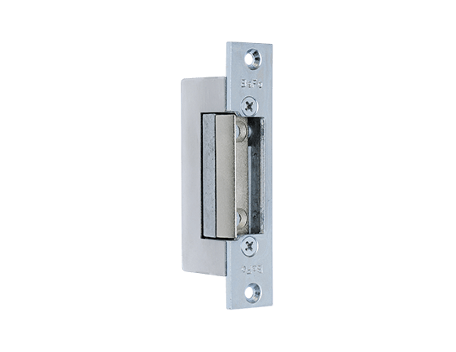
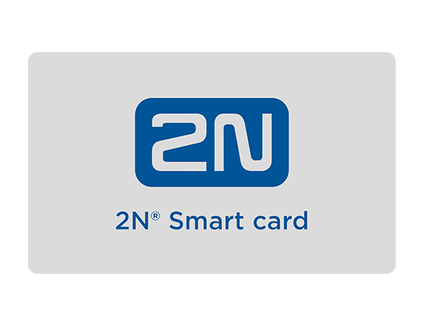
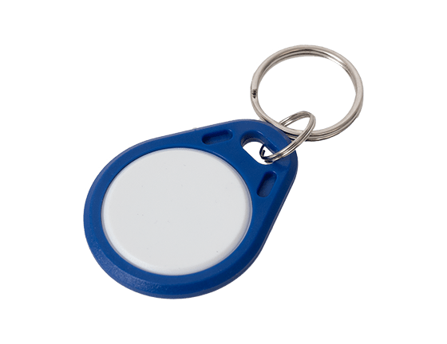
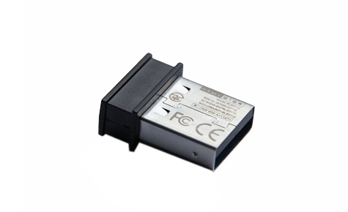
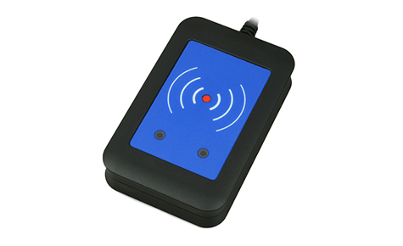
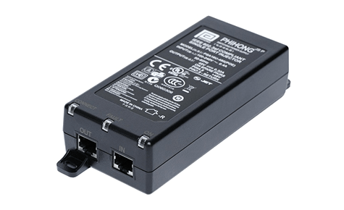
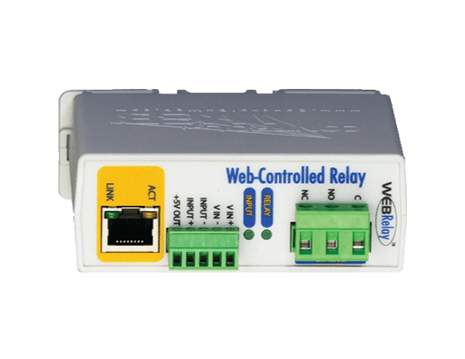
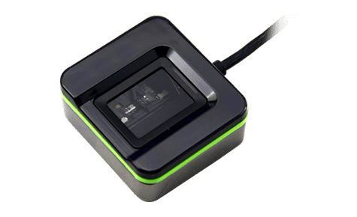
Additional accessories (common)
Communication & Access Control
HD audio and video quality
Open standards for integration
2N® Security Relay
Door strikes
RFID cards and fobs
External USB readers
PoE injector
External IP relay

Slide 15
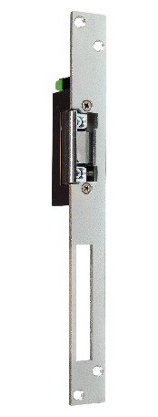
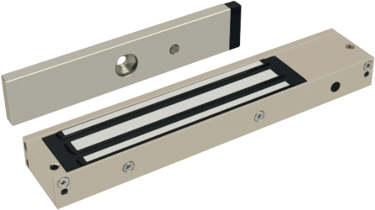
Recommended installation
Communication & Access Control
HD audio and video quality
Open standards for integration
Door strikes
DOOR
OUT1
Relay
2N® Security Relay
12V
2N Access Unit
Magnetic lock, electromechanical lock
For security reasons we strictly recommend you to:
always use an active OUT1 for any door strike / lock connection
always connect 2N® Security Relay between the 2N Access Unit and door lock

Slide 16
Ways of administration

Slide 17
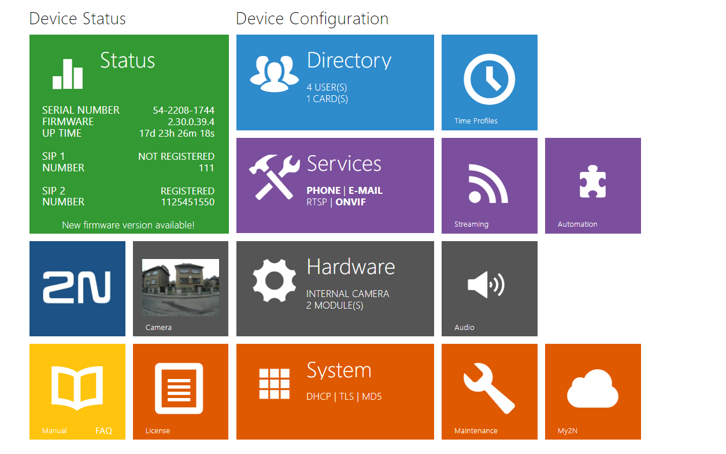
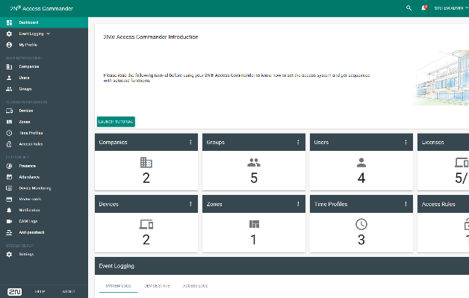
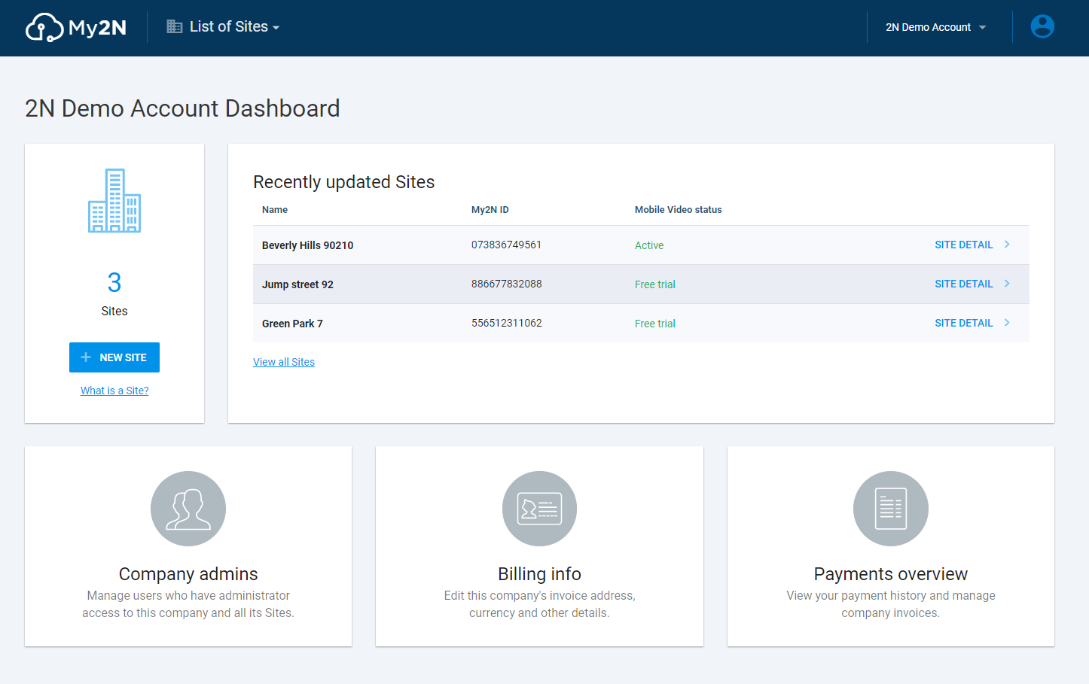
Ways of intuitive administration…
Web interface of the reader
Suitable for very small installations with up to 2 or 3 readers – no bulk management
Doesn’t support advanced features (T&A, visitor management)
2N® Access Commander
Tailored to SMB/SME type of installation with dozens of readers and intercoms
Professional access control SW for bulk management, monitoring and advanced features settings
2N® Remote Configuration
Designed for a residential (MDU) projects with couple of readers, intercoms and many indoor answering units
Simple remote configuration without any network settings – saving on travel cost
Notes:
And how you can configure and administrate the reader? There are three ways:
For really small installations up to 2-3 readers you can use only a web insterface of the reader itself. It has an intuitive interface, however doesn´t support bulk configuration, however it allows you to setup basic access control.
For typical SME / SMB installation we recommend you to use Access Commander – professional software for access control management with many advanced features. My colleague Gareth will talk about this software later on.
If you decide to install the reader in residential building, we can recommend you to use 2N® Remote Configuration. With this cloud-based service you can configure the reader remotely and save on travel cost!

Slide 18
Product comparison
(MDU and office buildings)
Notes:
Residential buildings – MDU
Office – focus on SME / SMB market

Slide 19
2N Access Unit M
2N Access Unit 2.0
Design: same as 2N® IP Verso intercom, two colors
Mounting: on glass, on wall, recessed
Vertical: residential (MDU)
Modularity: connection of extension modules
Design: slim, black only, similar to the upcoming intercom
Mounting: door frames, on wall
Vertical: office buildings
Modularity: N/A
Notes:
Now, let me highlight the main differences between our current Access Unit 2.0 and newly launched Access Unit M.
What is visible at first glance is the difference in design.
Despite all this, the units remain affordable.

Slide 20
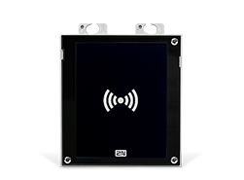
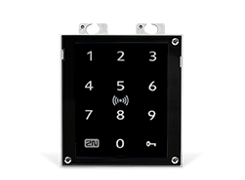
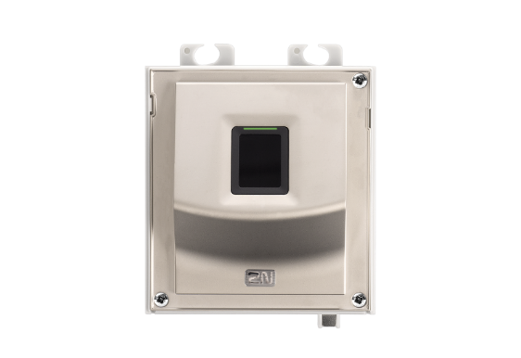
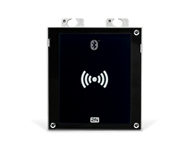
2N Access Unit 2.0
RFID (125kHz)
02137-001
Touch keypad
02262-001
Fingerprint reader
02263-001
RFID
(13.56MHz, NFC)
02142-001
RFID
(125kHz, 13.56MHz, NFC)
02146-001
Bluetooth & RFID
(125kHz, secured 13.56MHz, NFC)
01851-001
Touch Keypad & RFID
(125kHz, secured 13.56MHz, NFC)
01852-001

Slide 21
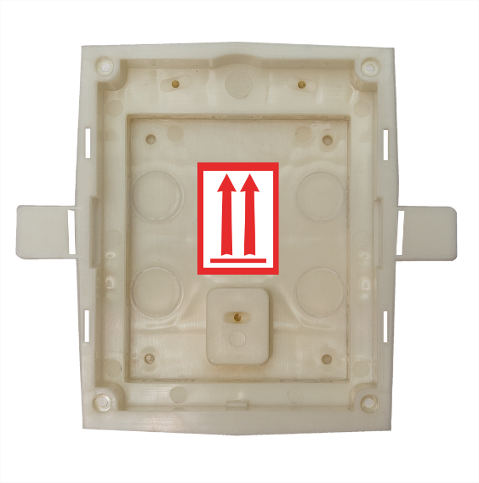
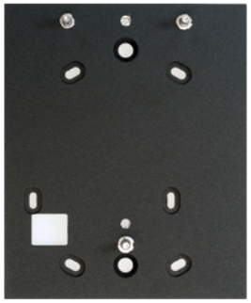
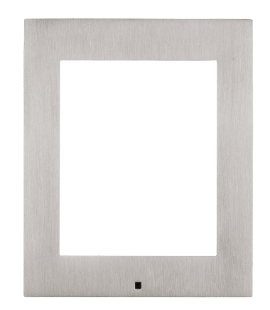
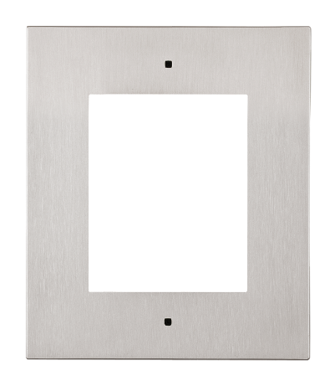
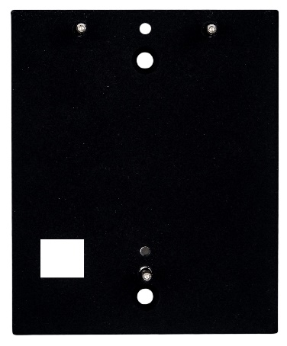
2N Access Unit 2.0
Mounting accessories
Frame – surface mount
01287-001 (nickel)
01288-001 (black)
Frame – flush mount
01278-001 (nickel)
01279-001 (black)
Backplate
01293-001
Gang plate – 1 module
01524-001
Flush installation box
01284-001

Slide 22
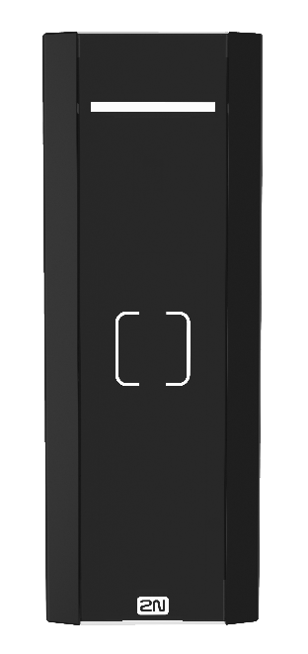
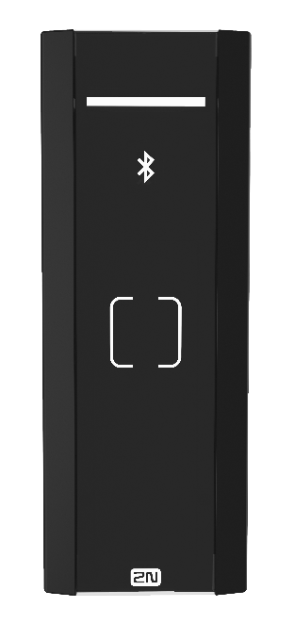
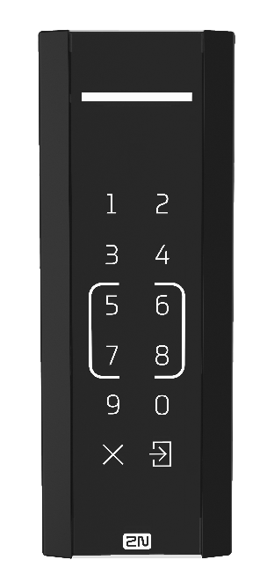
2N Access Unit M
RFID
(13.56MHz, NFC)
02393-001
RFID
(125kHz, 13.56MHz, NFC)
02394-001
Bluetooth & RFID
(125kHz, 13.56MHz, NFC)
02395-001
Touch Keypad & RFID
(125kHz, 13.56MHz, NFC)
02396-001

Slide 23
Easy quotation and quick installation
Reliable mobile access
Smart and secure 2N OS
Saves your time and generates more business
Notes:
I’d like to quickly summarise the key points that I have shared with you today:
~ I showed you how easy and quick is to quote and install this reader
~ I also mentioned our reliable mobile access control that is so requested today because of its convenience
~ and I point out the key benefits of our own 2N OS
All of these together will differentiate you against the competitors, save your time and generate new opportunities for you, which means more business and more money.

Slide 24
Part of the
2N Access Unit
An ideal reader for your access control project

