Slide 1

2N Answering Units
Stylish indoor communicators for any apartment
www.2n.com

Slide 2
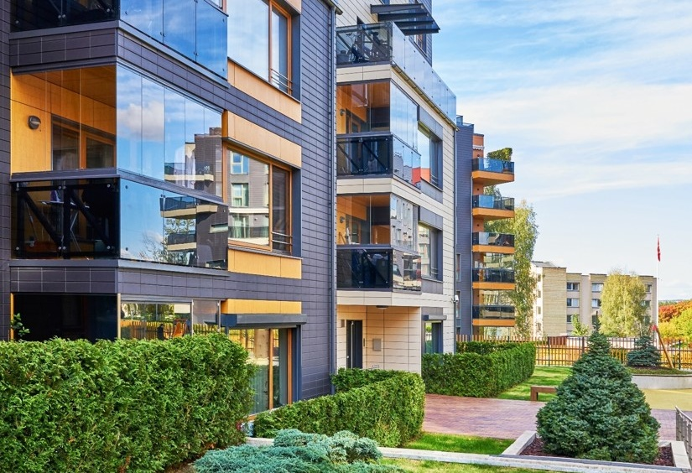


Verticals
Residential
Apartment
building
Residential
Single
house
Office
Office
building

Slide 3
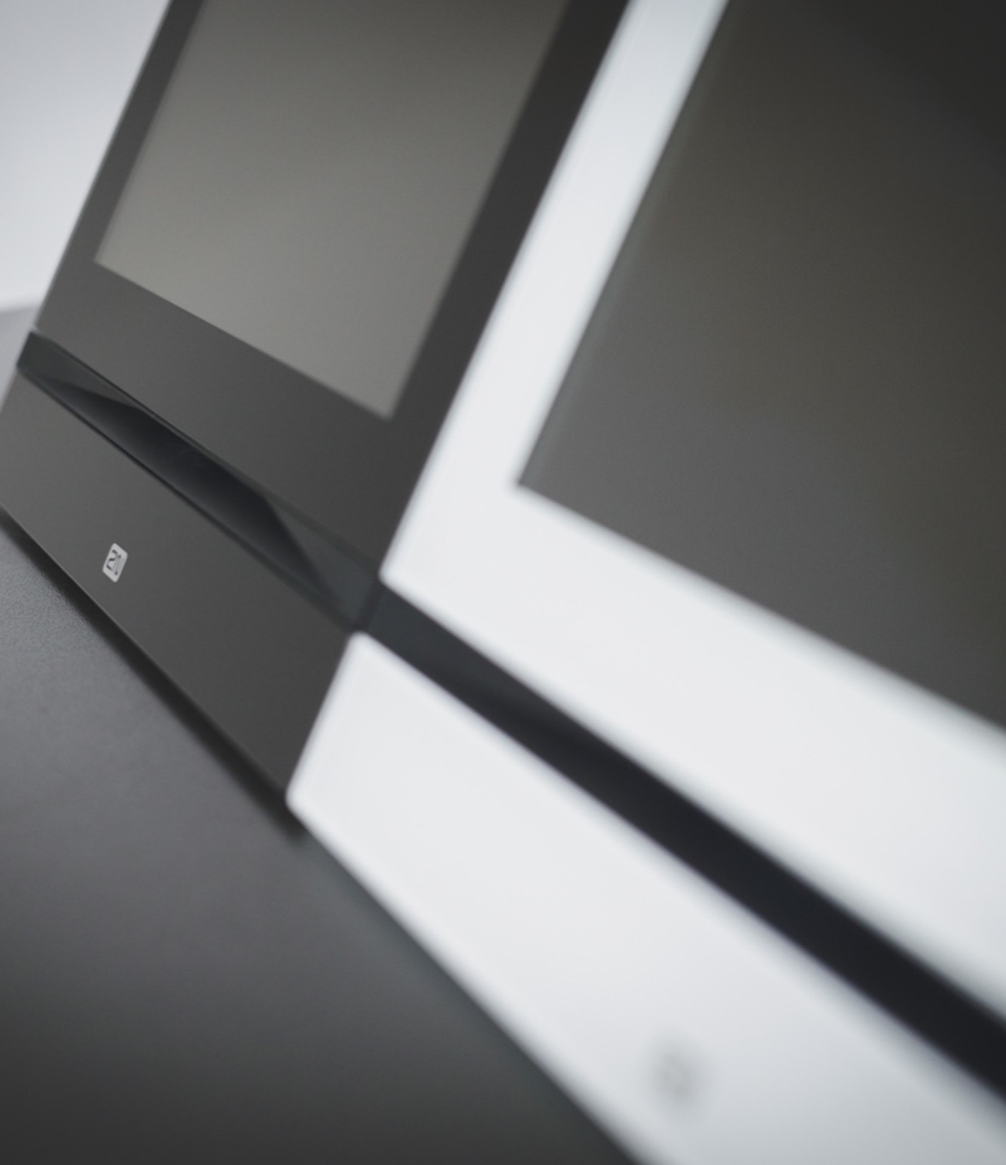
General Overview
Award-winning design
Red Dot and iF Design awards set a high bar
in terms of design
Choose your OS
Units with the 2N OS won’t let you down. For advanced integrations, choose Android
Cybersecure
Prevent cyberattacks and give preference to European products

Slide 4
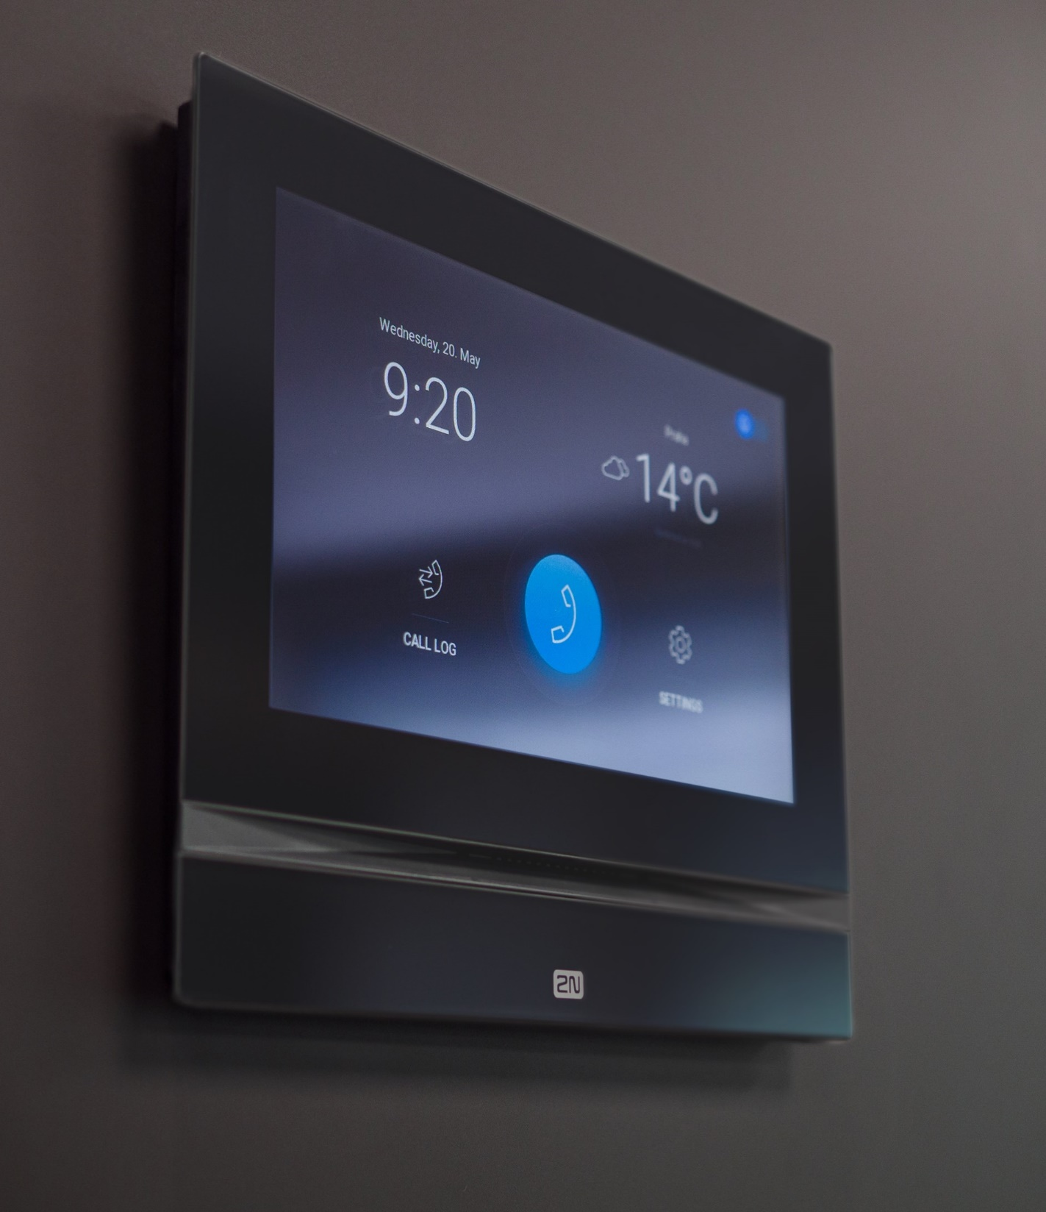
General Overview
Go for IP
It offers easy connection, configuration and
power over ethernet
In-wall, on-wall or on a table
Find the right type of installation you need for your project, every time
Retrofit ready
No wiring? Make free calls over the internet
and discover the other benefits of My2N cloud

Slide 5
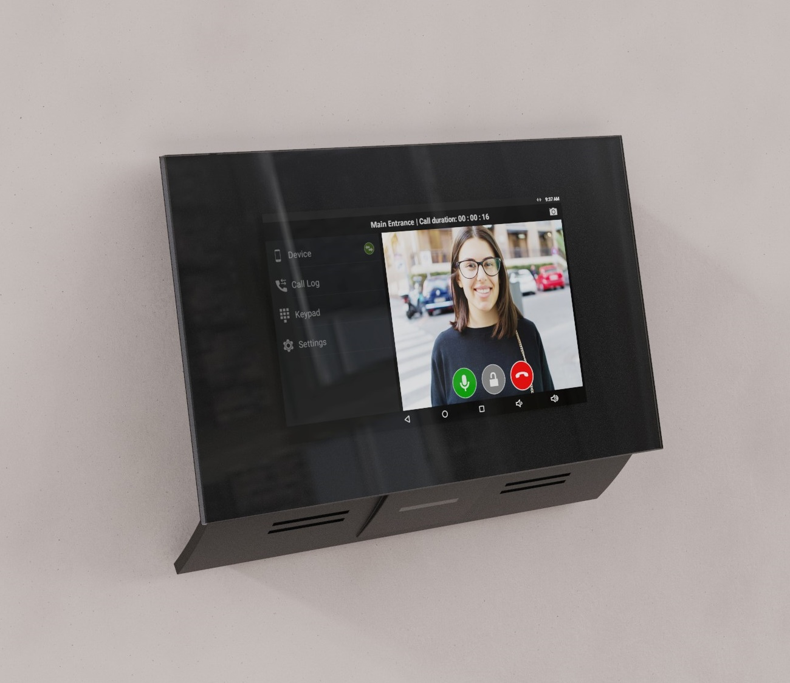

2N® Indoor Touch 2.0
Multifunctional panel with Android OS
Integration with home automation systems
Video recording for playing back missed calls
Durable 7“ HD touch screen

Slide 6
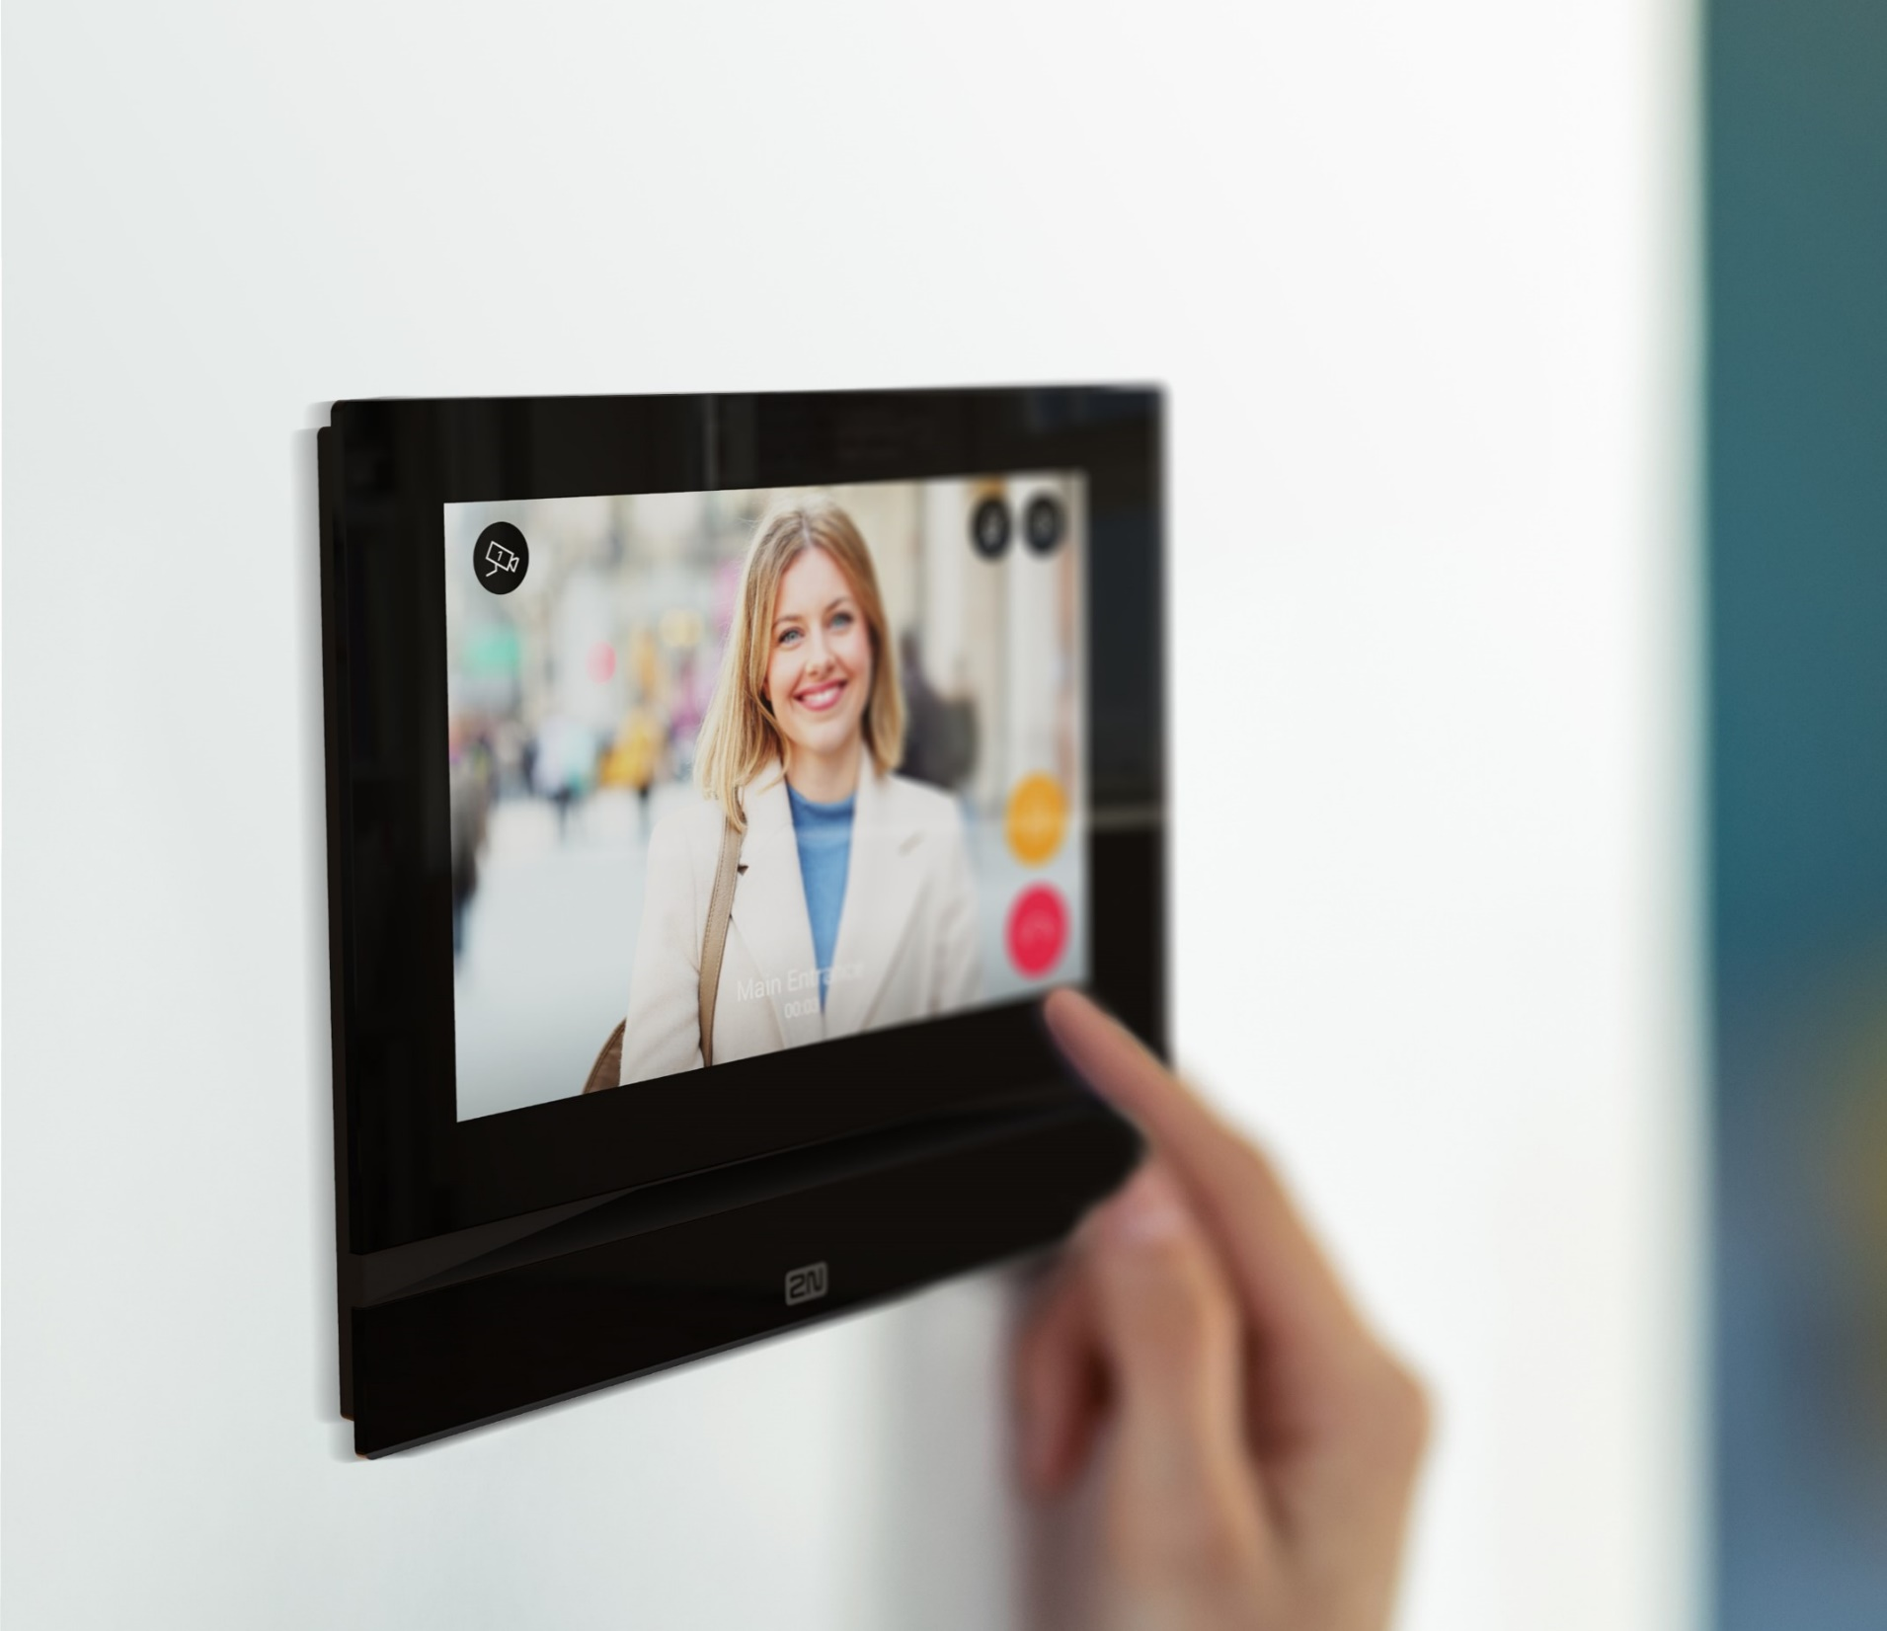
2N® Indoor View
Sleek answering unit with 7" touch display
Support of HD video calls
Video surveillance
Smart home integration

Slide 7
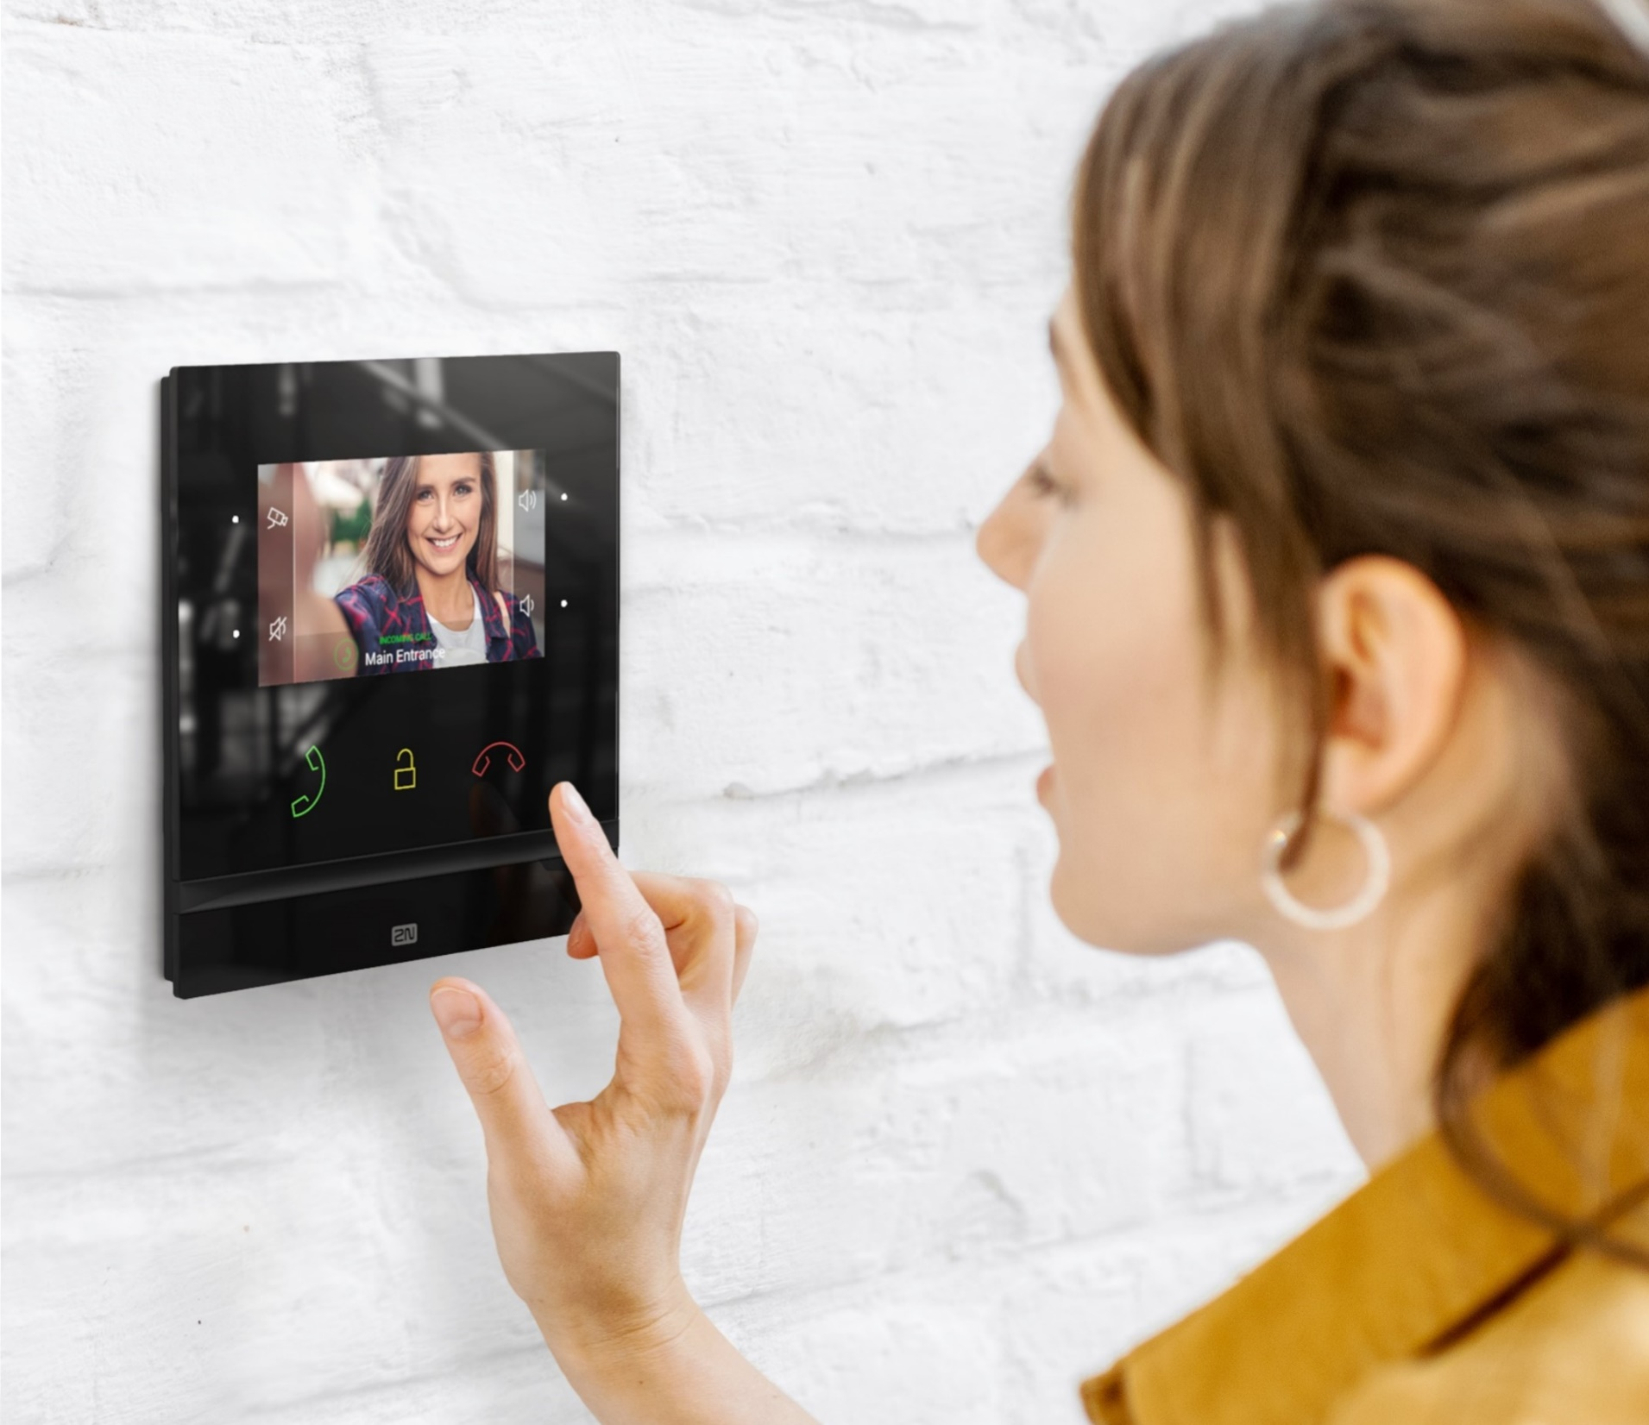
2N® Indoor Compact
Midsized video answering unit
Durable 4.3” display
Backlit touch buttons
Smart home integration

Slide 8

2N® Clip
Indoor station for
mid-priced projects
4.3” display
Touch buttons
Quick installation

Slide 9
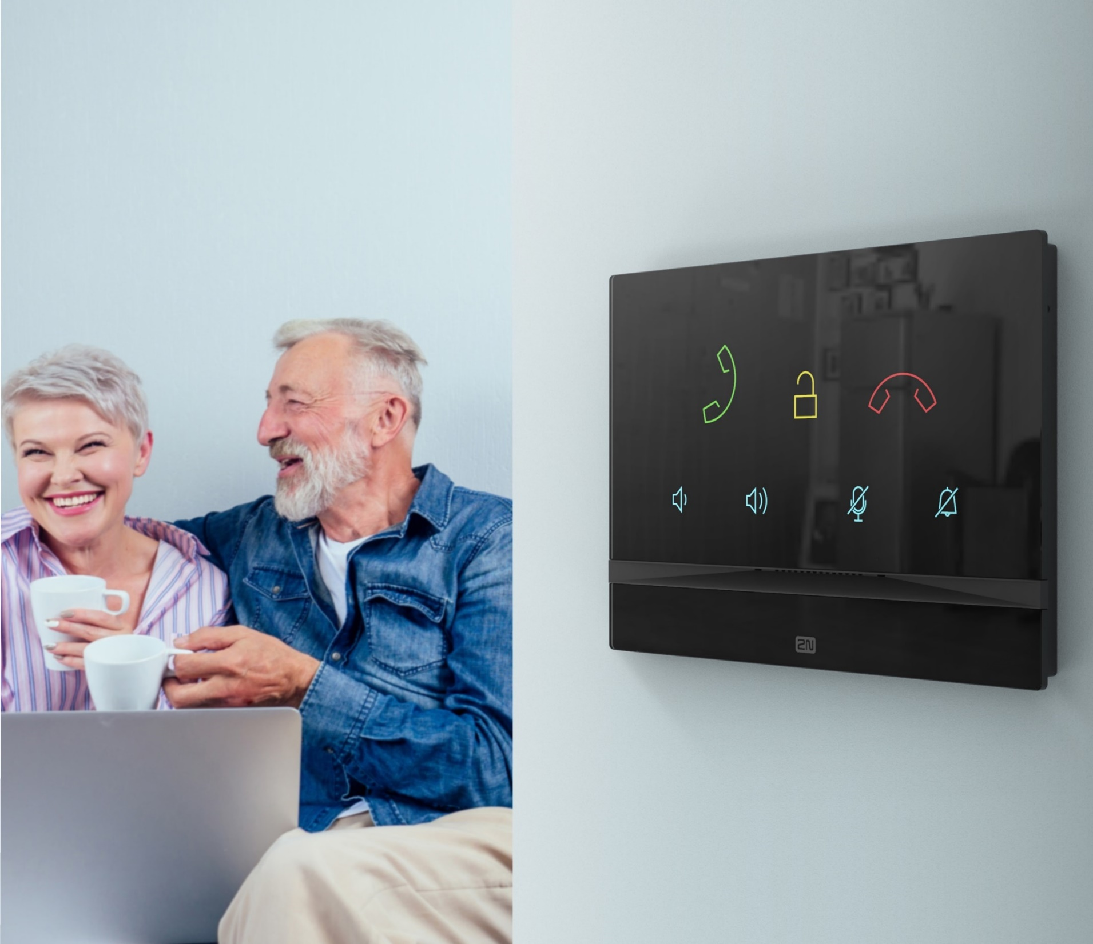

2N® Indoor Talk
More than just an audio answering unit
Crystal clear sound
Large backlit icons for easy control
3mm thick glass with an anti-scratch finish

Slide 10

My2N App
Receive calls from intercoms via mobile
99.98% reliability rate
Round the clock home surveillance
Answer doors from anywhere

Slide 11
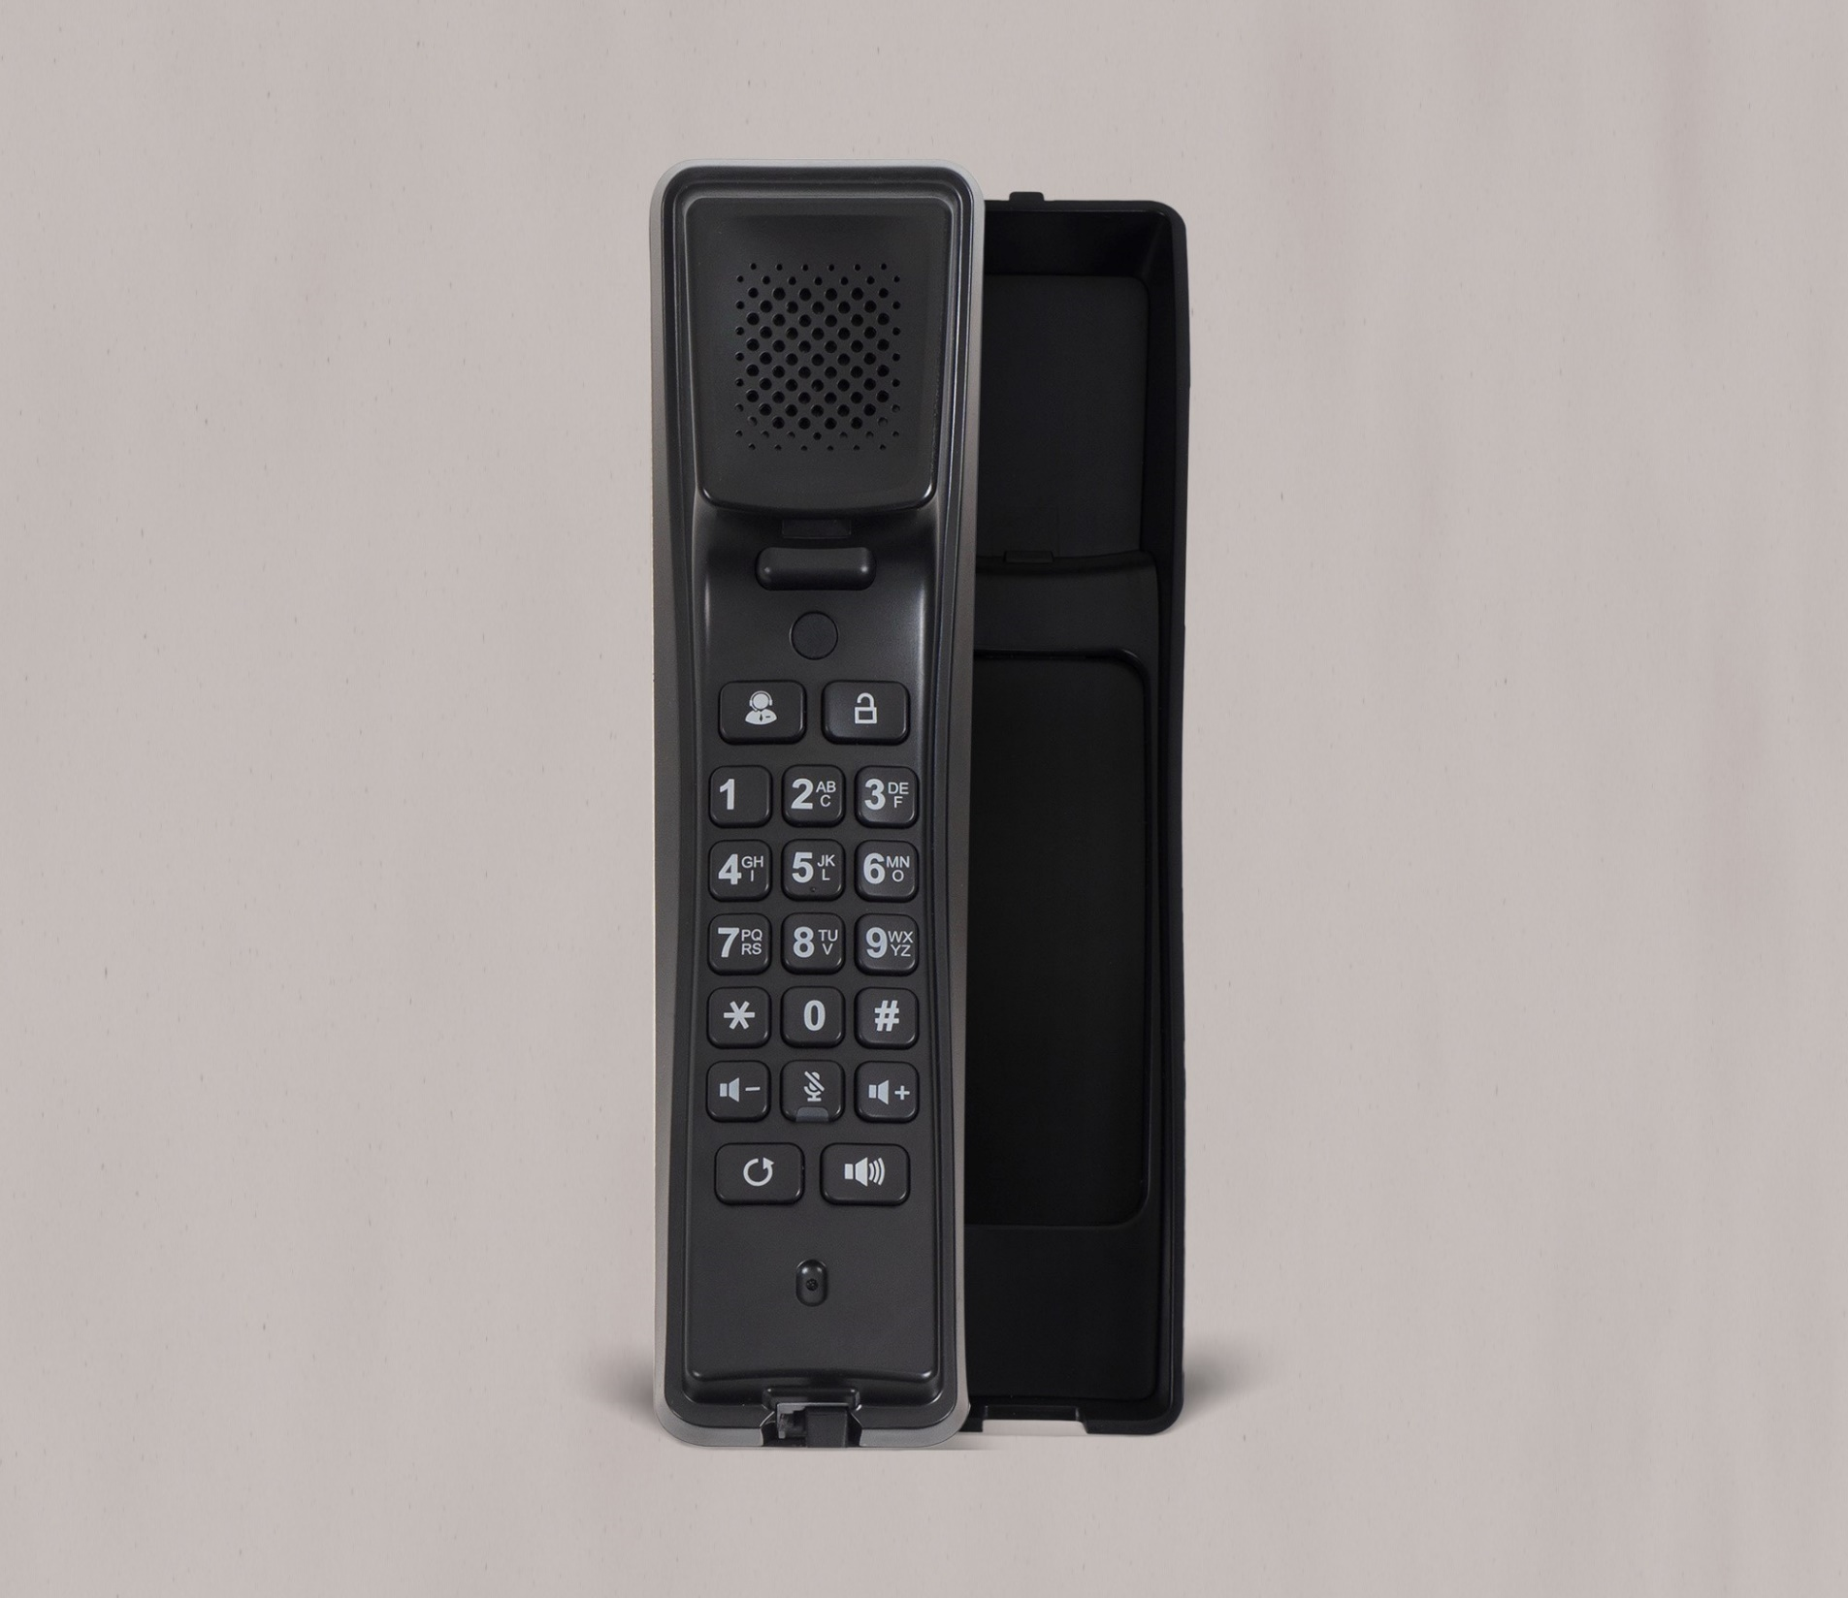
2N® IP Handset
Entry-level answering unit
Audio-only IP unit
Dedicated button to open the door
Possibility to send HTTP command

Slide 12
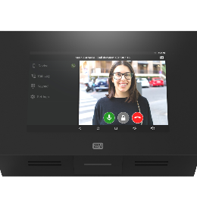
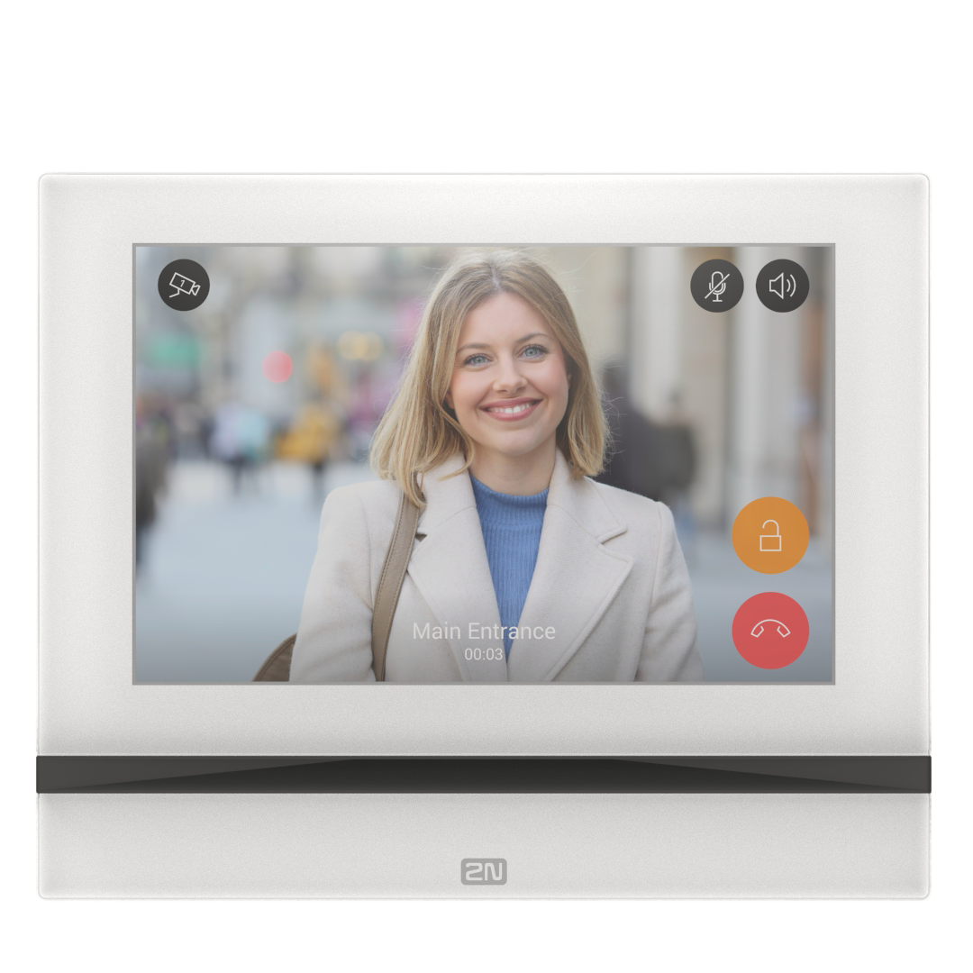
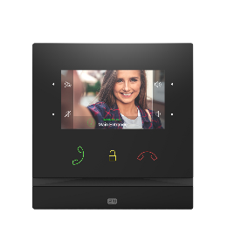
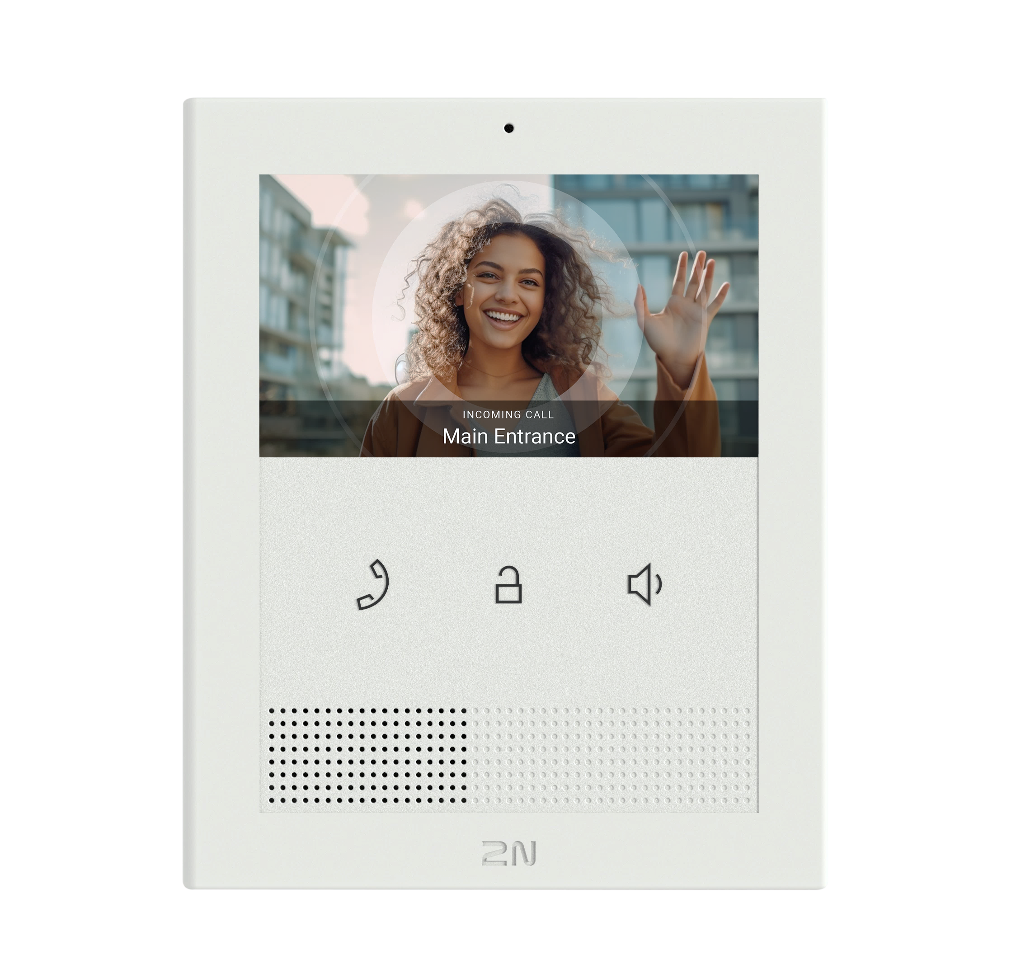
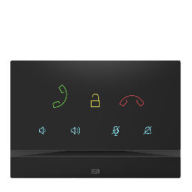
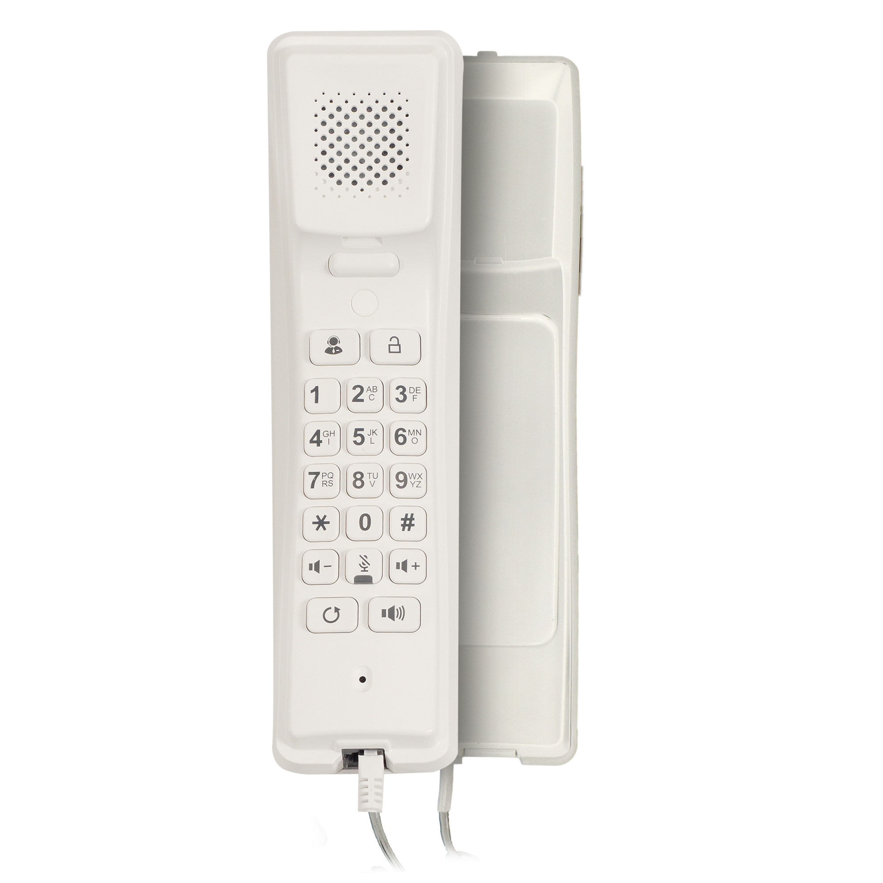

Answering Unit Portfolio
Home Automation
High-end
4” video
Premium audio only
High-end
7” full screen
Mobile
Cost effective video
Cost effective

Slide 13
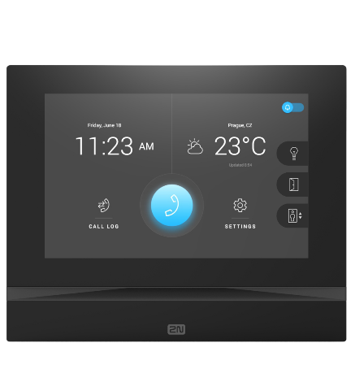
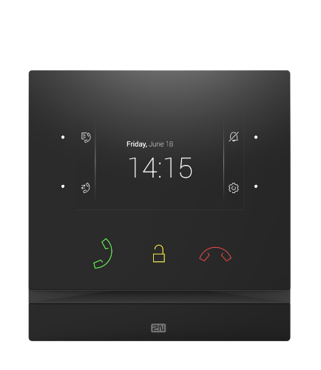
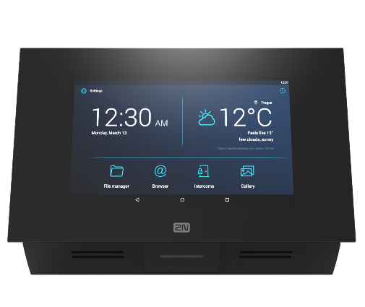
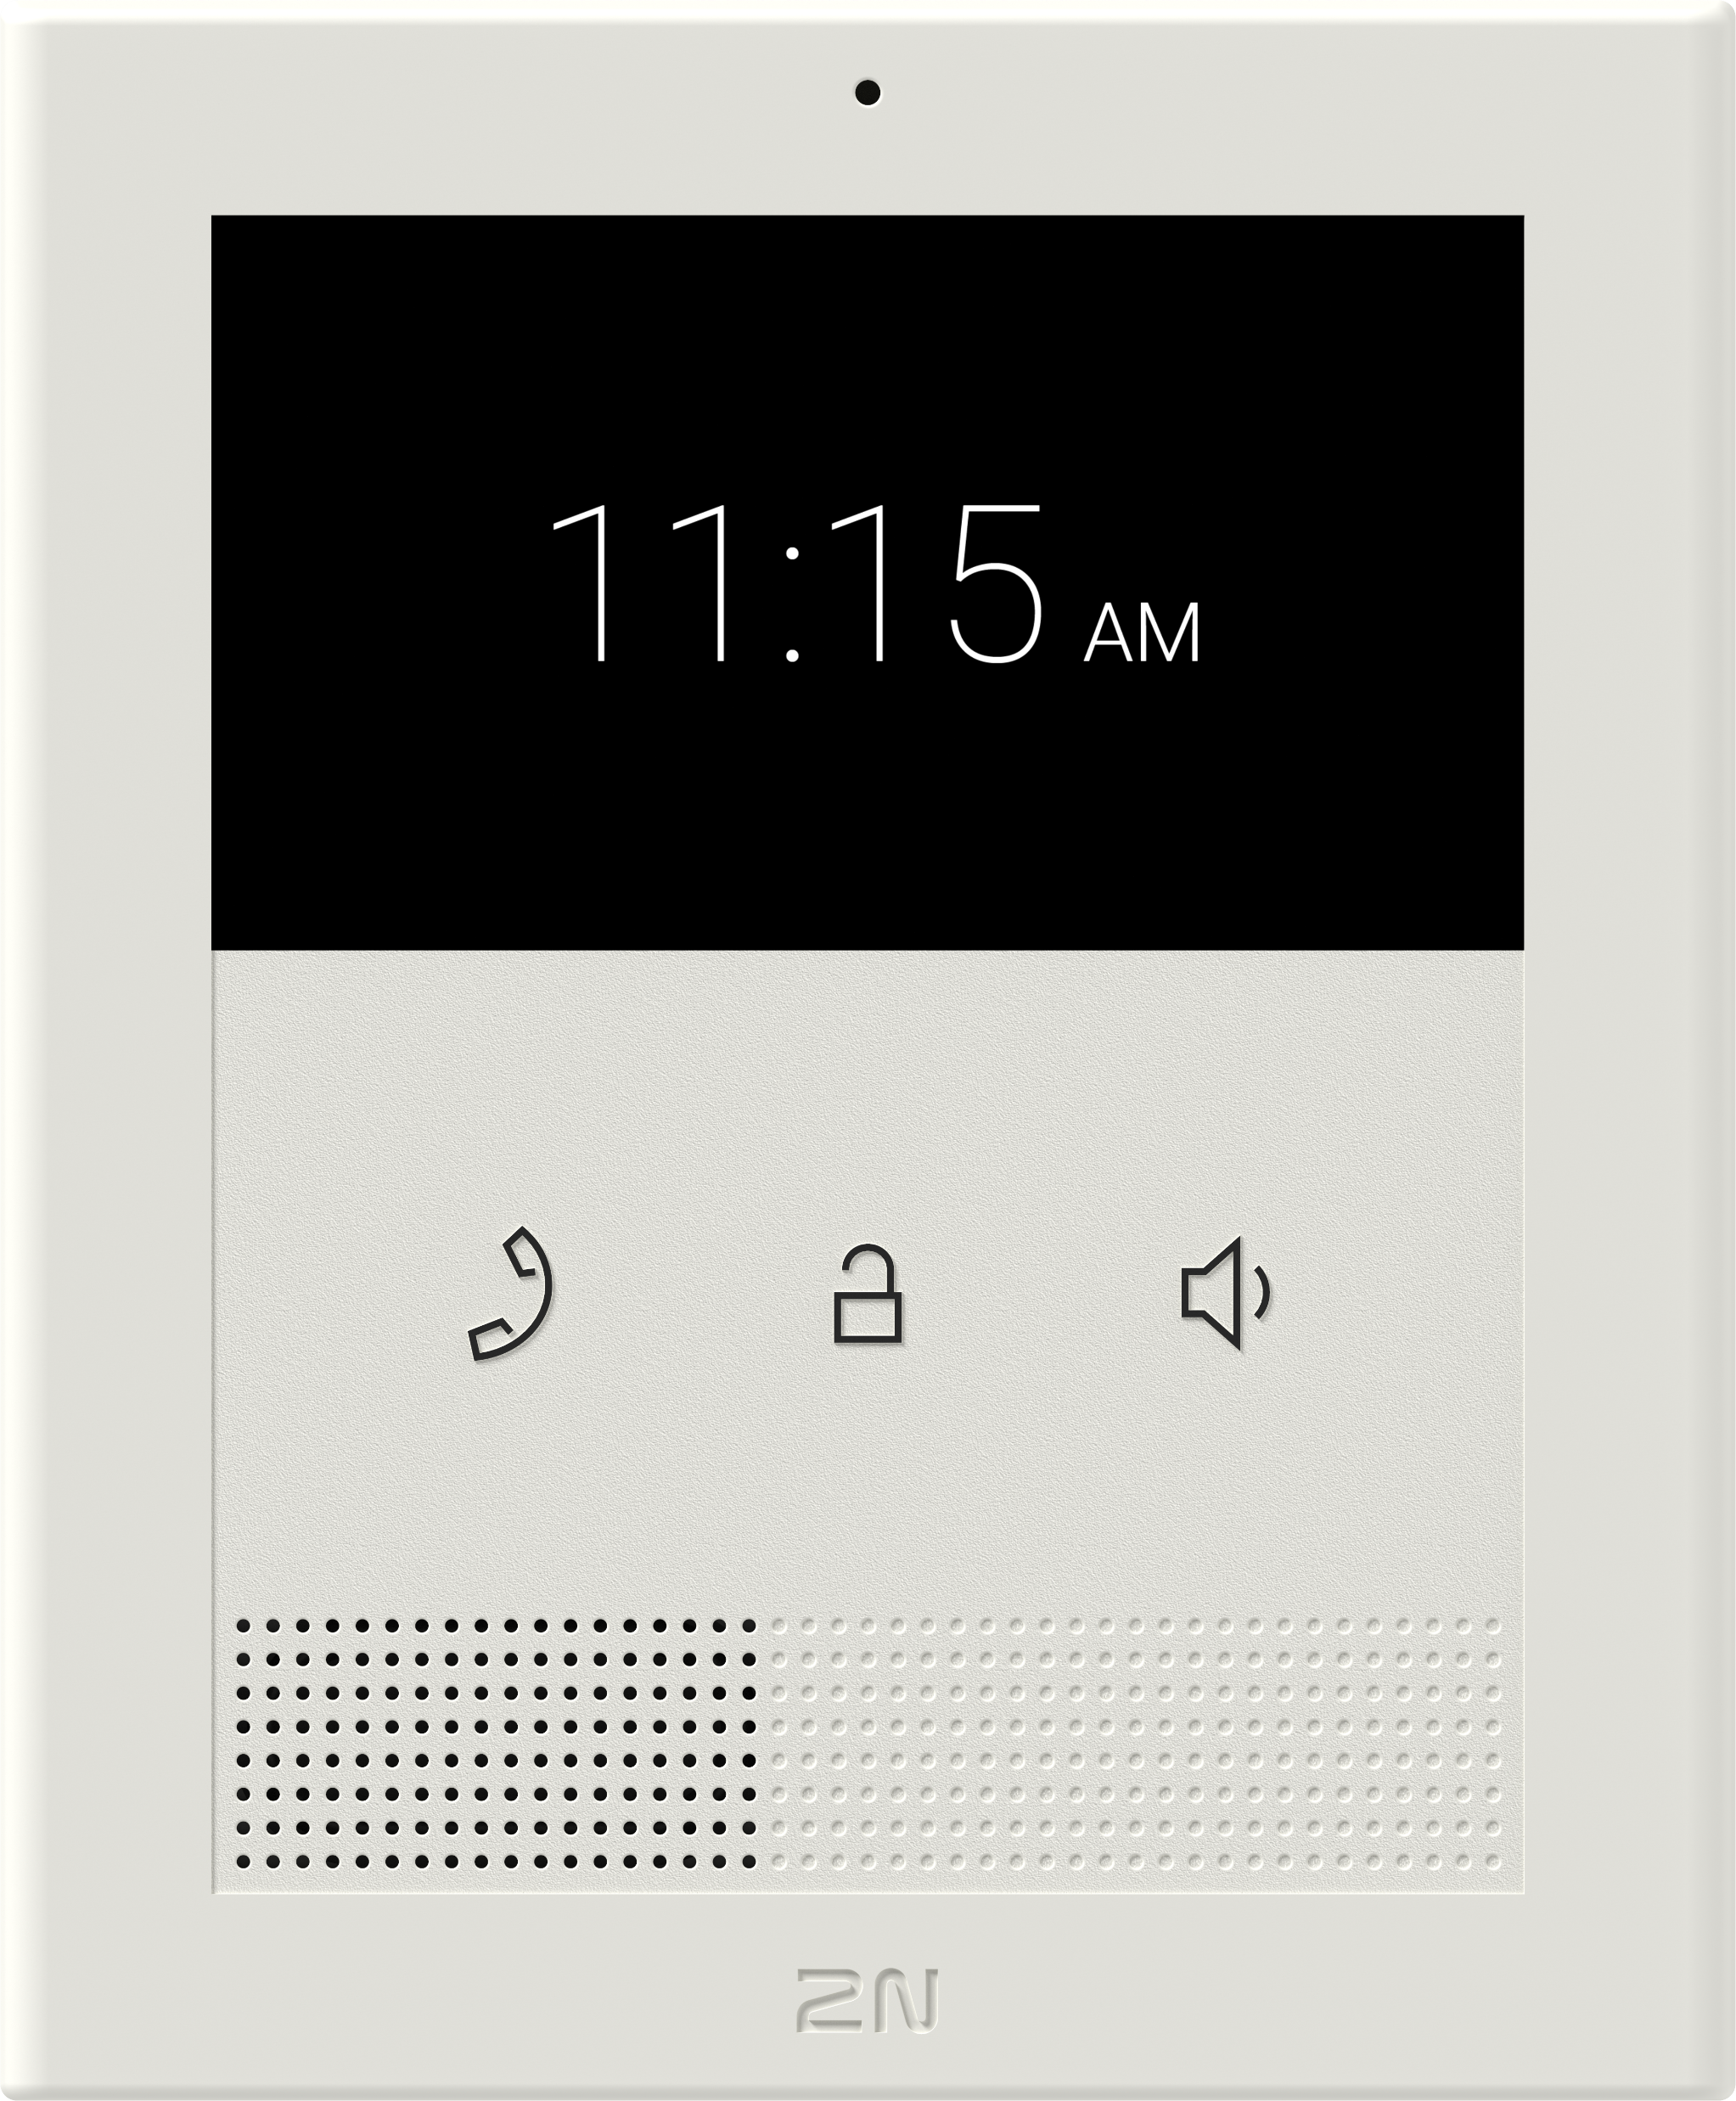
Order Numbers
2N® Indoor Touch 2.0
2N® Indoor View
2N® Indoor Compact
2N® Clip
91378375
(black)
91378375WH
(white)
91378601
(black)
91378601WH
(white)
91378501
(black)
91378501WH
(white)
9138511
(ethernet)
9138512
(ethernet, induction loop)

Slide 14
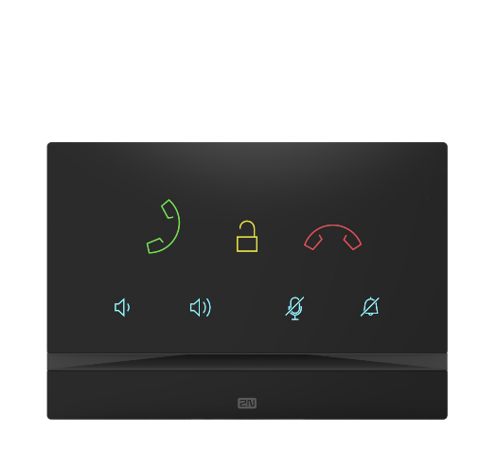
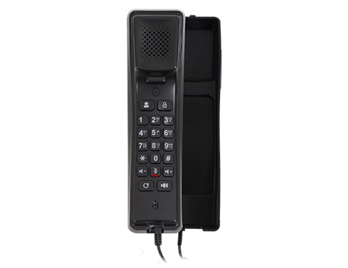
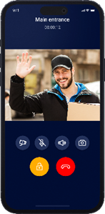
Order Numbers
2N® Indoor Talk
2N® IP Handset
My2N App
91378401
(black)
91378401WH
(white)
1120101B
(black)
1120101W
(white)
9137957
(annual device subscription)
9137958
(annual apartment subscription)

Slide 15
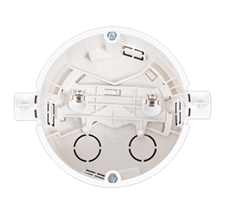
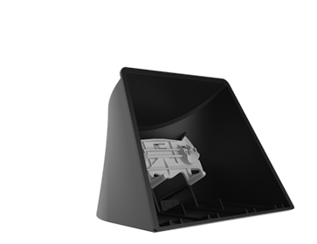
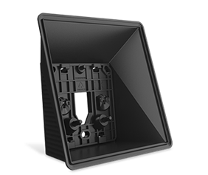
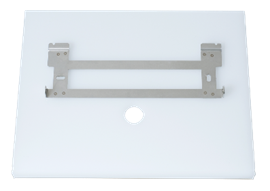
Order Numbers
2N Indoor Flush Box
(for 2N® Indoor View, Compact, Talk)
2N Indoor Surface Box
(for 2N® Indoor View, Compact)
2N Indoor Desk Stand
(for 2N® Indoor View, Compact, Talk)
Stand for
2N® Indoor Touch 2.0
91378800
(mandatory accessory
for flush installation)
91378803
(mandatory accessory
for surface installation)
91378382
(mandatory accessory
for desk installation)
91378382
(black)
91378382W
(white)

Slide 16

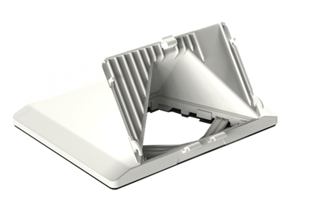
Order Numbers
Flush mounted
power supply
(for 2N® Indoor Touch 2.0)
2N Clip Desk Stand
91378380
9138002
(mandatory accessory
for desk installation)

Slide 17
Rely on the high standards of European products
www.2n.com

